Slide 2
Diving into Mastery Guidance for Educators
Each activity sheet is split into three sections, diving, deeper and deepest, which are represented by the following icons:
These carefully designed activities take your children through a learning journey, initially ensuring they are fluent with the key concept being taught; then applying this to a range of reasoning and problem-solving activities.
These sheets might not necessarily be used in a linear way. Some children might begin at the ‘Deeper’ section and in fact, others may ‘dive straight in’ to the ‘Deepest’ section if they have already mastered the skill and are applying this to show their depth of understanding.
Diving
Deeper
Deepest

Slide 3
Aim
Recognise the place value of each digit in a four-digit number.

Slide 4
Partitioning
Diving
Write a statement to show the values and then calculate the total amount.
1000
100
10
1
1000
10
10
1000
100
10
1
1000
100
10
1000
10
5000
+
300
+
60
+
2
=
5362

Slide 5
Partitioning
Diving
Fill in the gaps to complete the calculations.
4000
+
100
+
90
+
3
=
4193
1000
+
5900
+
50
+
42
=
6992

Slide 6
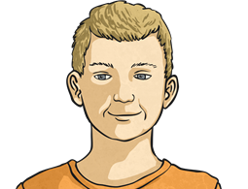
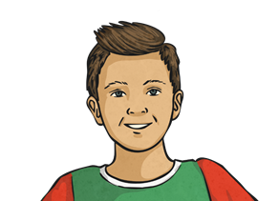
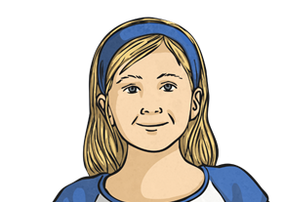
Partitioning
Deeper
Whose ticket is whose? Use the clues to help you.
My ticket has one more hundred than it has thousands.
The tens digit of my ticket is three times the ones digit.
My ticket has fifty-four ones.
My ticket has eighty-two tens.
My number has one hundred.
Alan
Steven
Daphne
Eva
Gloria
7654
3469
4062
2192
5821

Slide 7
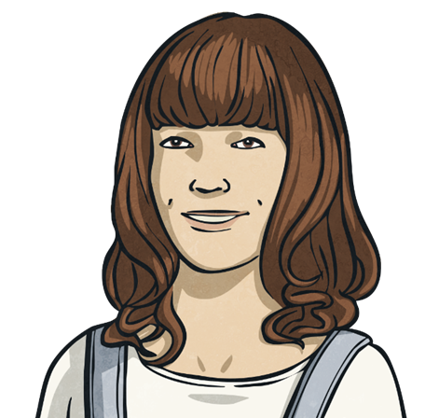
Partitioning
Deepest
Jana uses some place value counters to make the number 5432.
1000
100
10
1
How many different ways can you find to make the same total?

Slide 8
Partitioning
Deepest
There are lots of different ways. Here are some examples:
5002 ones 430 tens | 3 thousands 20 hundreds 432 ones
1000
1000
1000
1000
1000
1000
1000
1000
1000
1
10
10
10
1
100
100
100
100
100
100
100
100
100
1
100
100
100
100
100
10
10
10
1
100
100
100
100

Slide 9
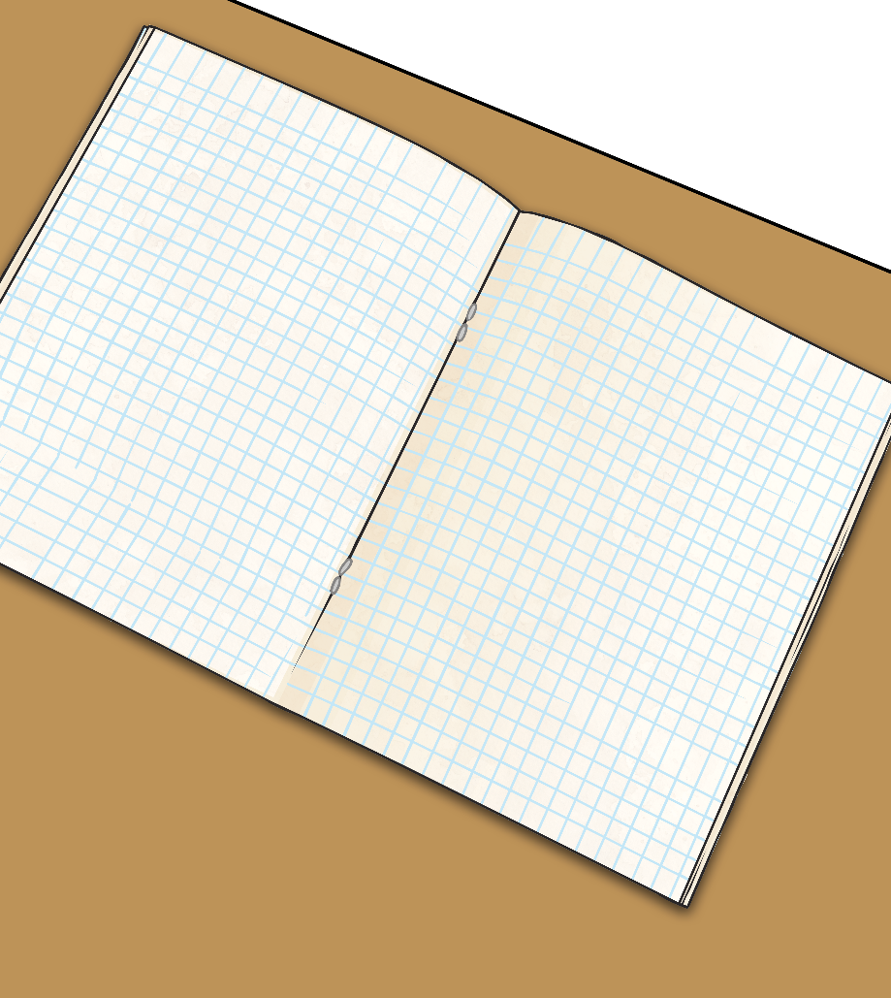
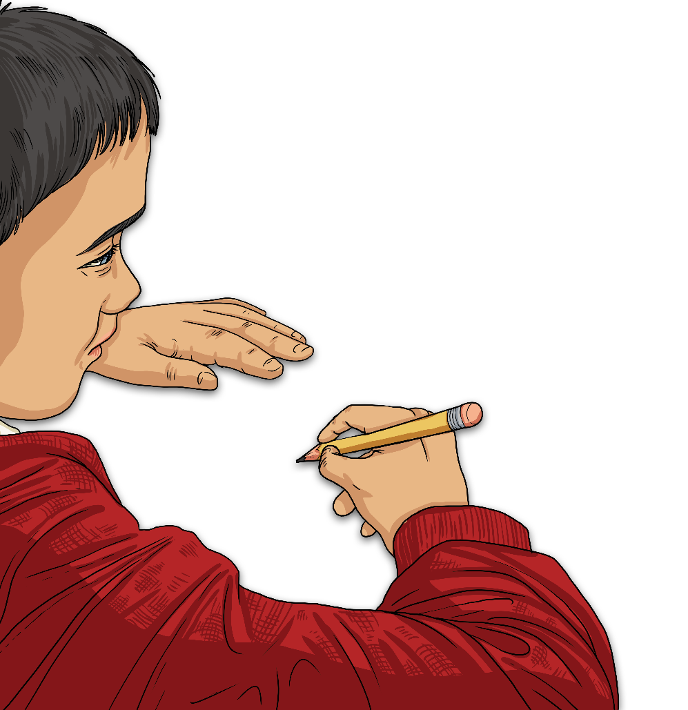
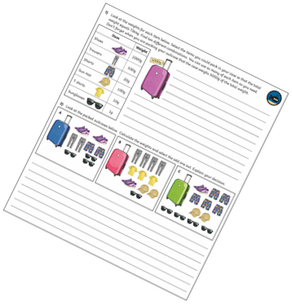
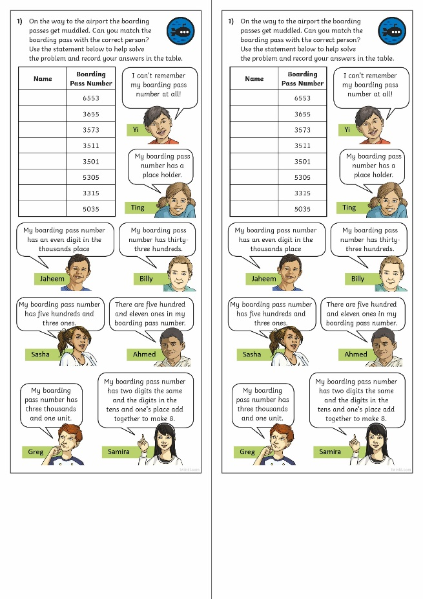
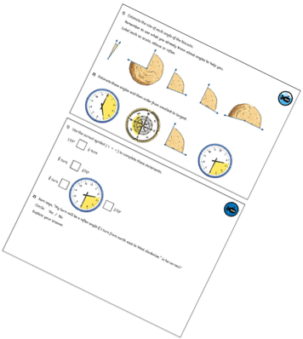
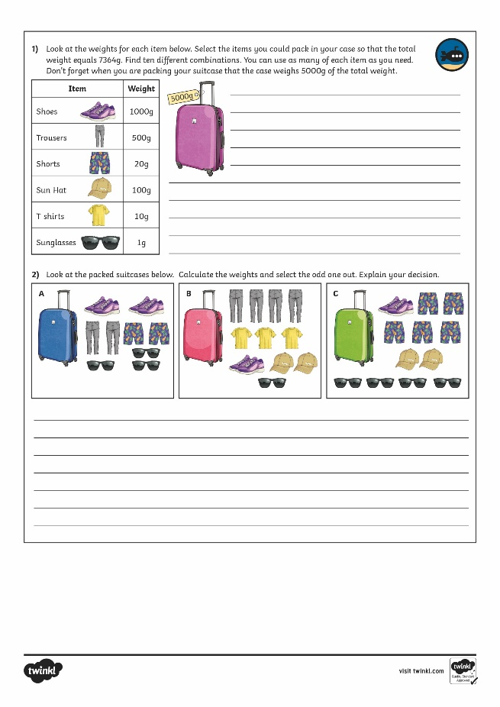
Partitioning
Dive in by completing your own activity!

Slide 10
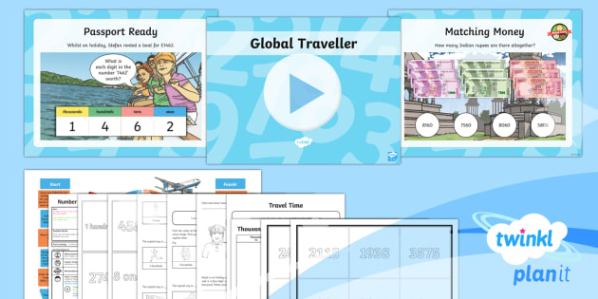
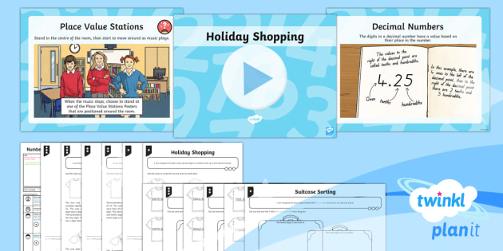
Need Planning to Complement this Resource?
National Curriculum Aim
Recognise the place value of each digit in a four-digit number.
For more planning resources to support this aim, click here.
Twinkl PlanIt is our award-winning scheme of work with over 4000 resources.

