Slide 1
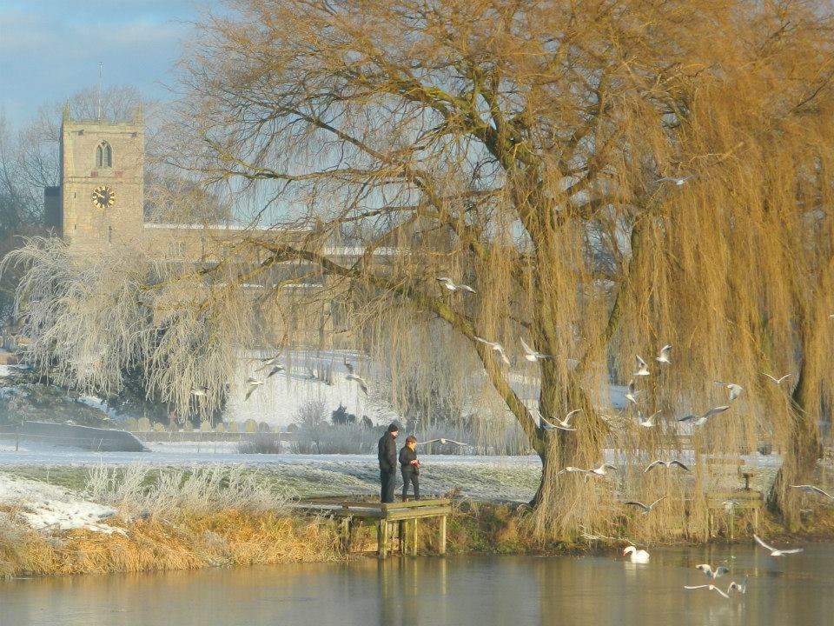
Welcome to Warsop
Today we are going to give a tour around Warsop. Warsop is a rural area. Warsop has a lot of shops and schools including buildings. Warsop has a few parks aswell. Do you want to go to the church? I love Warsop, I could walk around all day.
By Nancy, Layla and Abbey

Slide 2
Information
There is 3 schools in Warsop, they are called Birklands, Sherwood, Hetts Lane and Meden School.
There is a church and near to this is a park with a lake called The Carrs, it’s a lovely place to go for a walk and see the swans.
There are lots of shops in Warsop, a post office and a library too.

