Slide 1
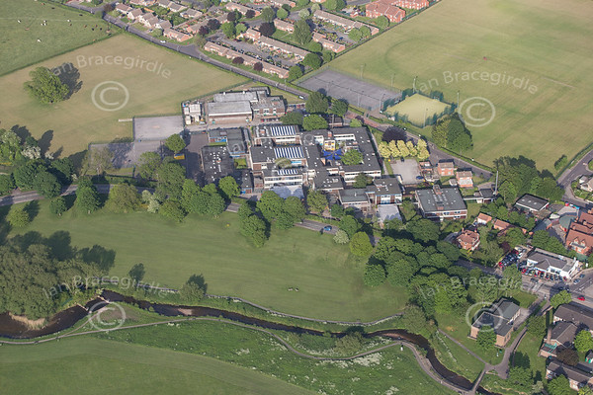
Warsop
Hi welcome to Warsop we are going to show you some places in Market Warsop. Here is The carrs and there is is a park in The Carrs. There is Birklands Primary School, this is where we go to school . There is the post office and the church . There is The carrs river and you can see it on a picture on the next page .
By Cody and Poppy

Slide 2
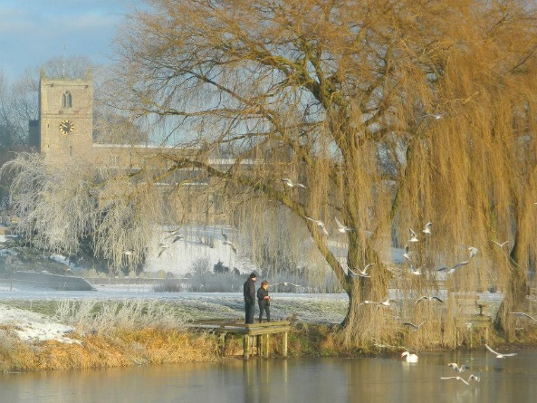
Information
Warsop is a wonderful place to visit and it more wonderful then ever. It has a very long lake called the Meden River and my brother goes to Meden school its named after the river. There’s a place called Sandy Lane that’s where Meden school is.

