Slide 1
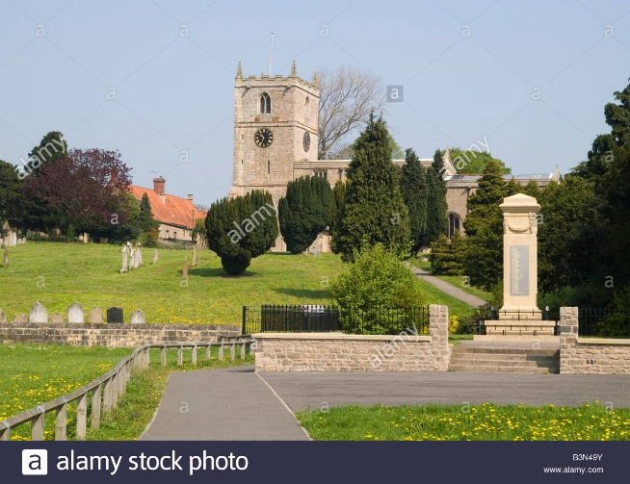
Kid president leads a tour around Warsop
Welcome to warsop
Bella &Ellie

Slide 2
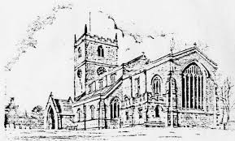
Information about warsop church
The church is a place where you go to pray.
The church is where there is a cenotaph for the soldiers that have died.

Slide 3
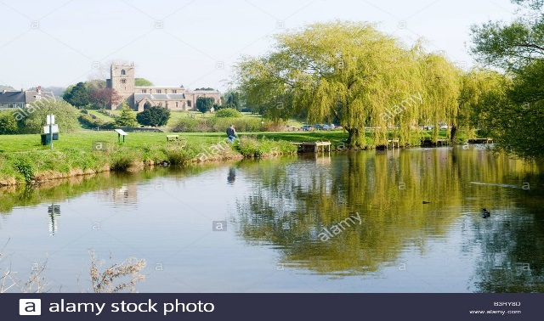
The carRs
The carrs is where the ducks are
You can go for a lovely walk or visit the park there

