Slide 1
Meet The Teacher
Mrs Henderson and Miss Scrivener

Slide 2
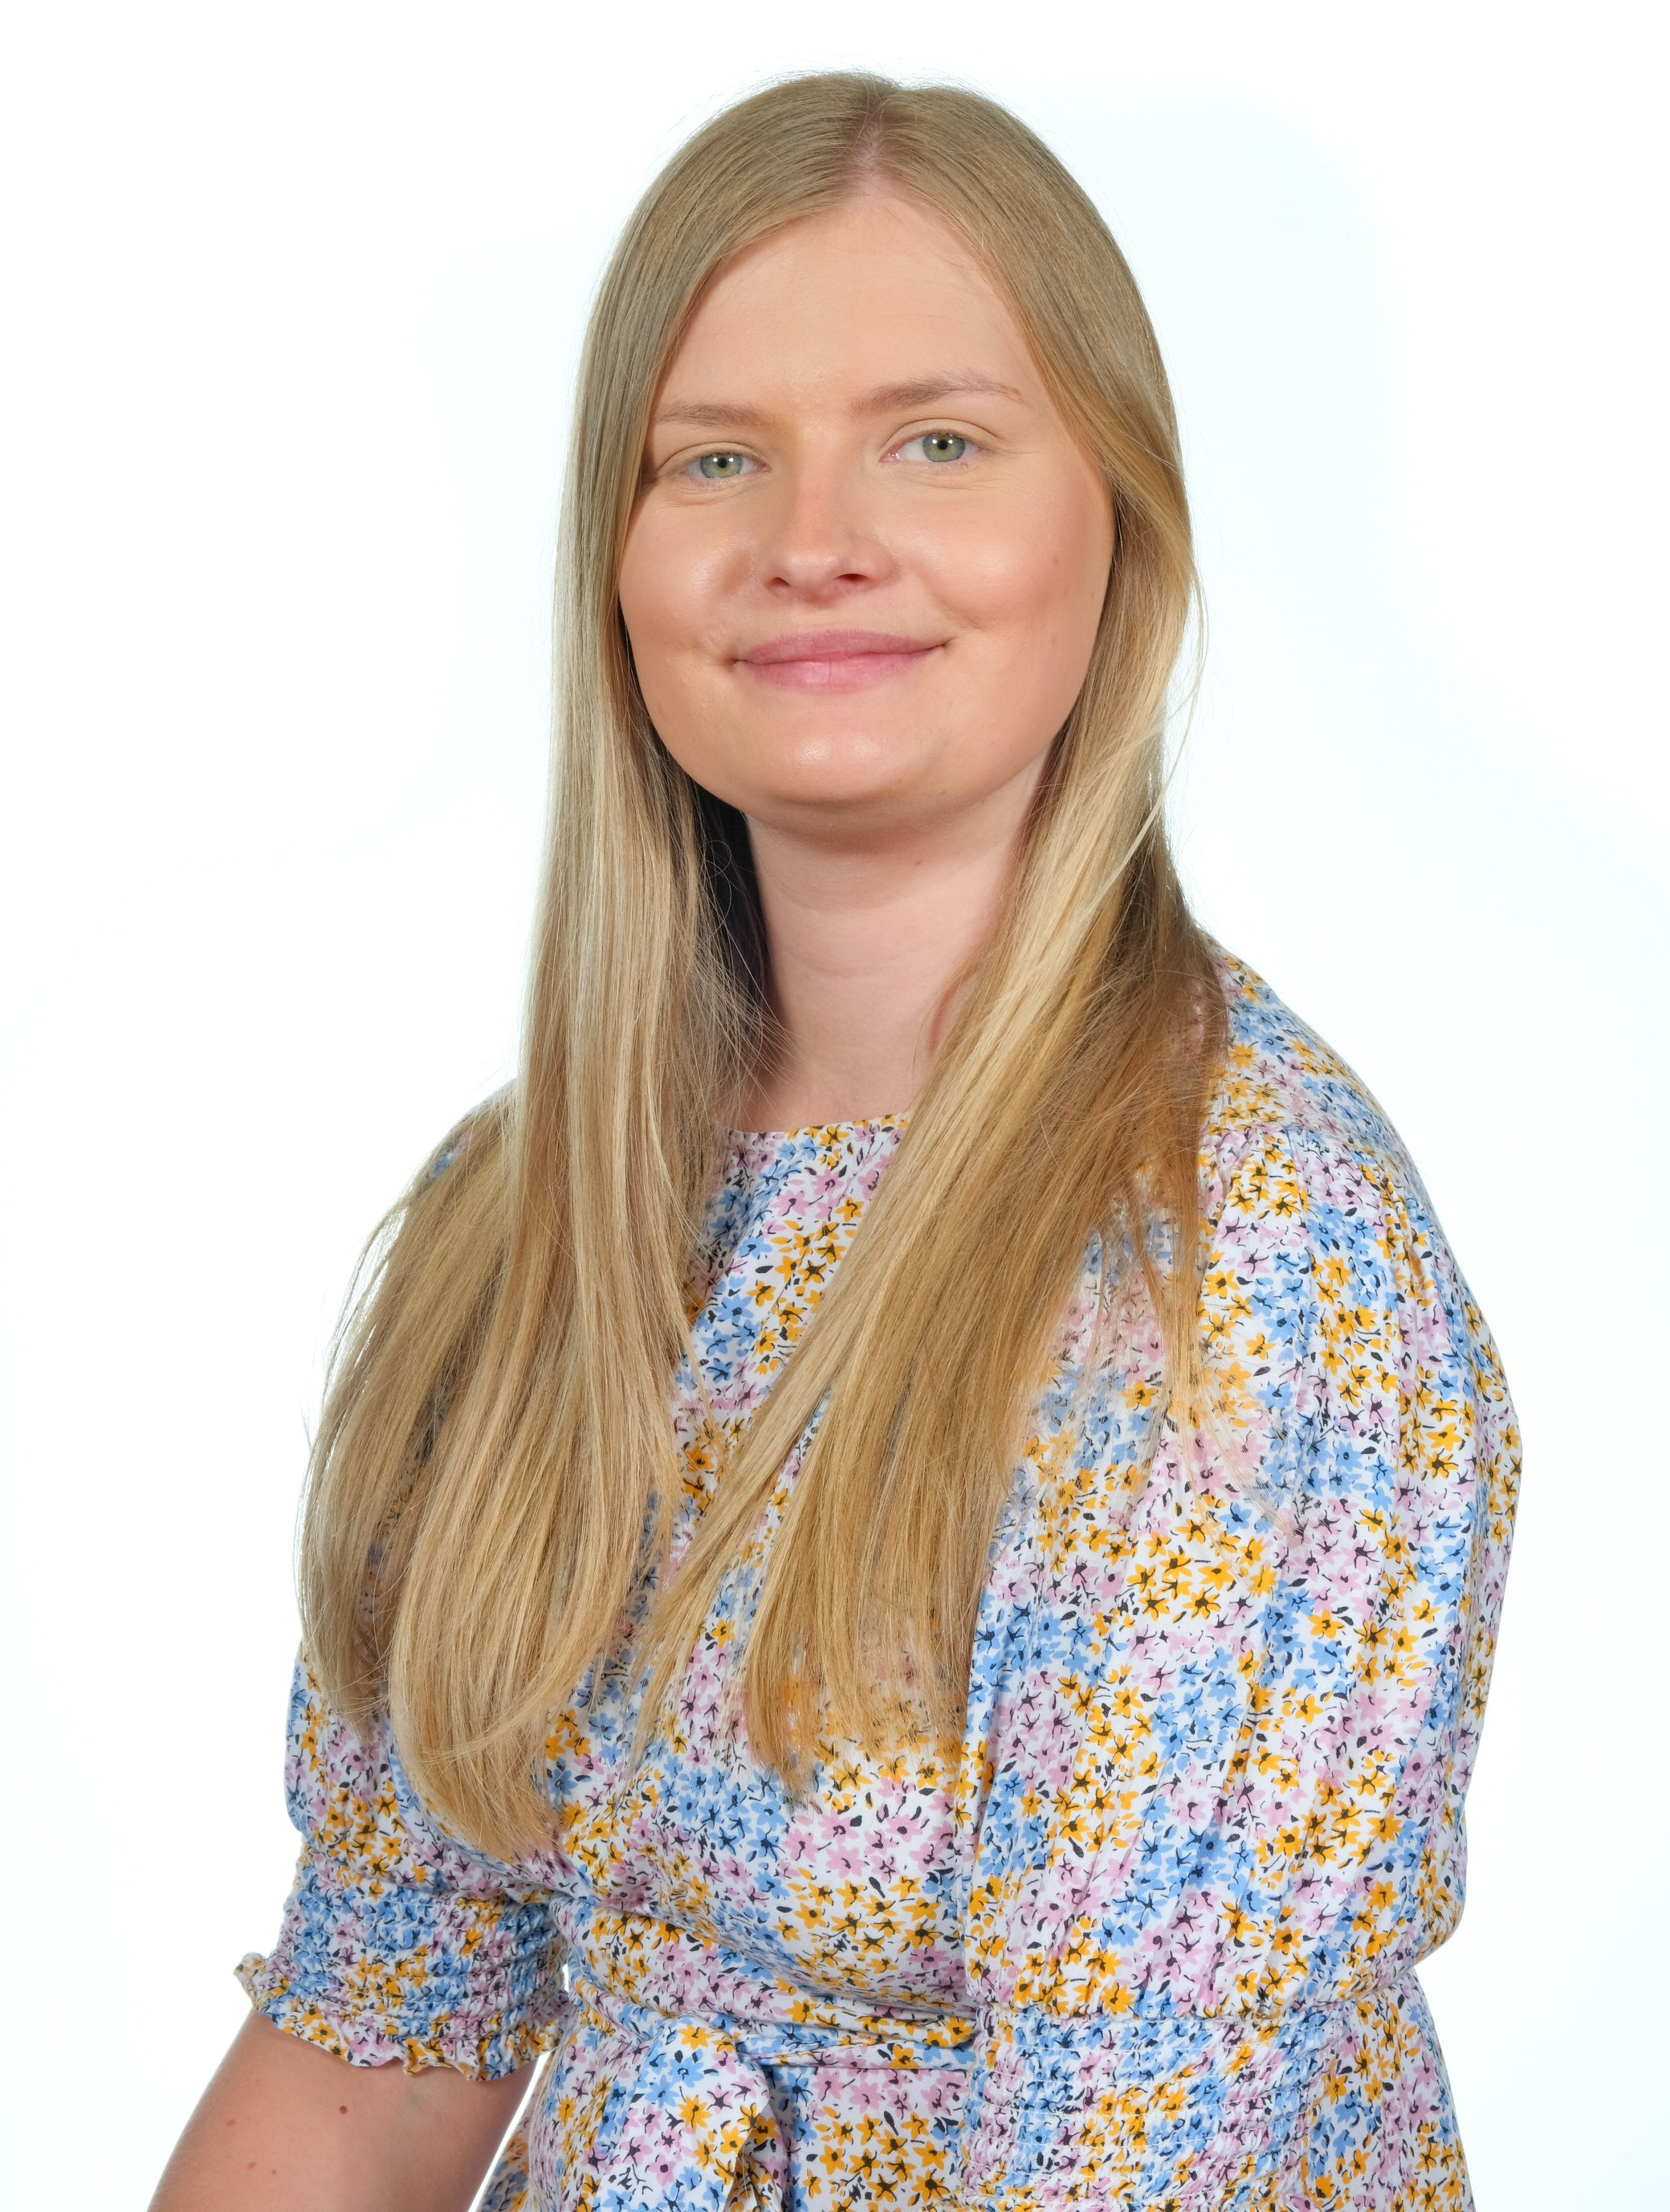
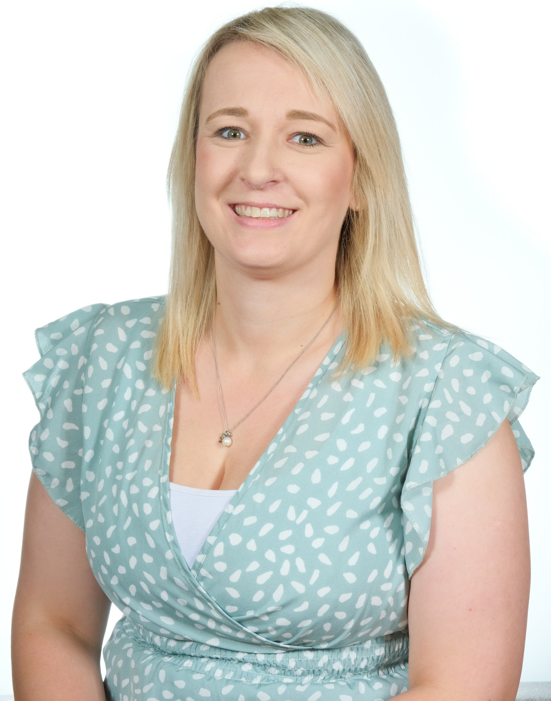
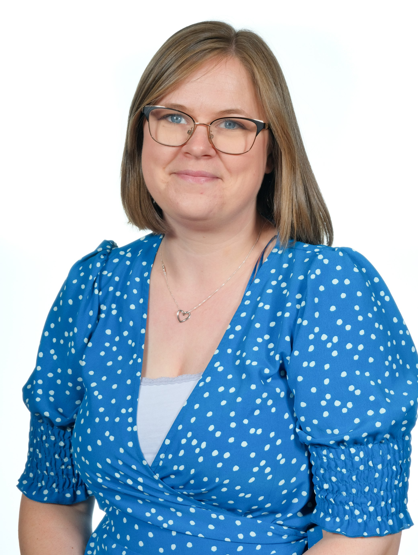
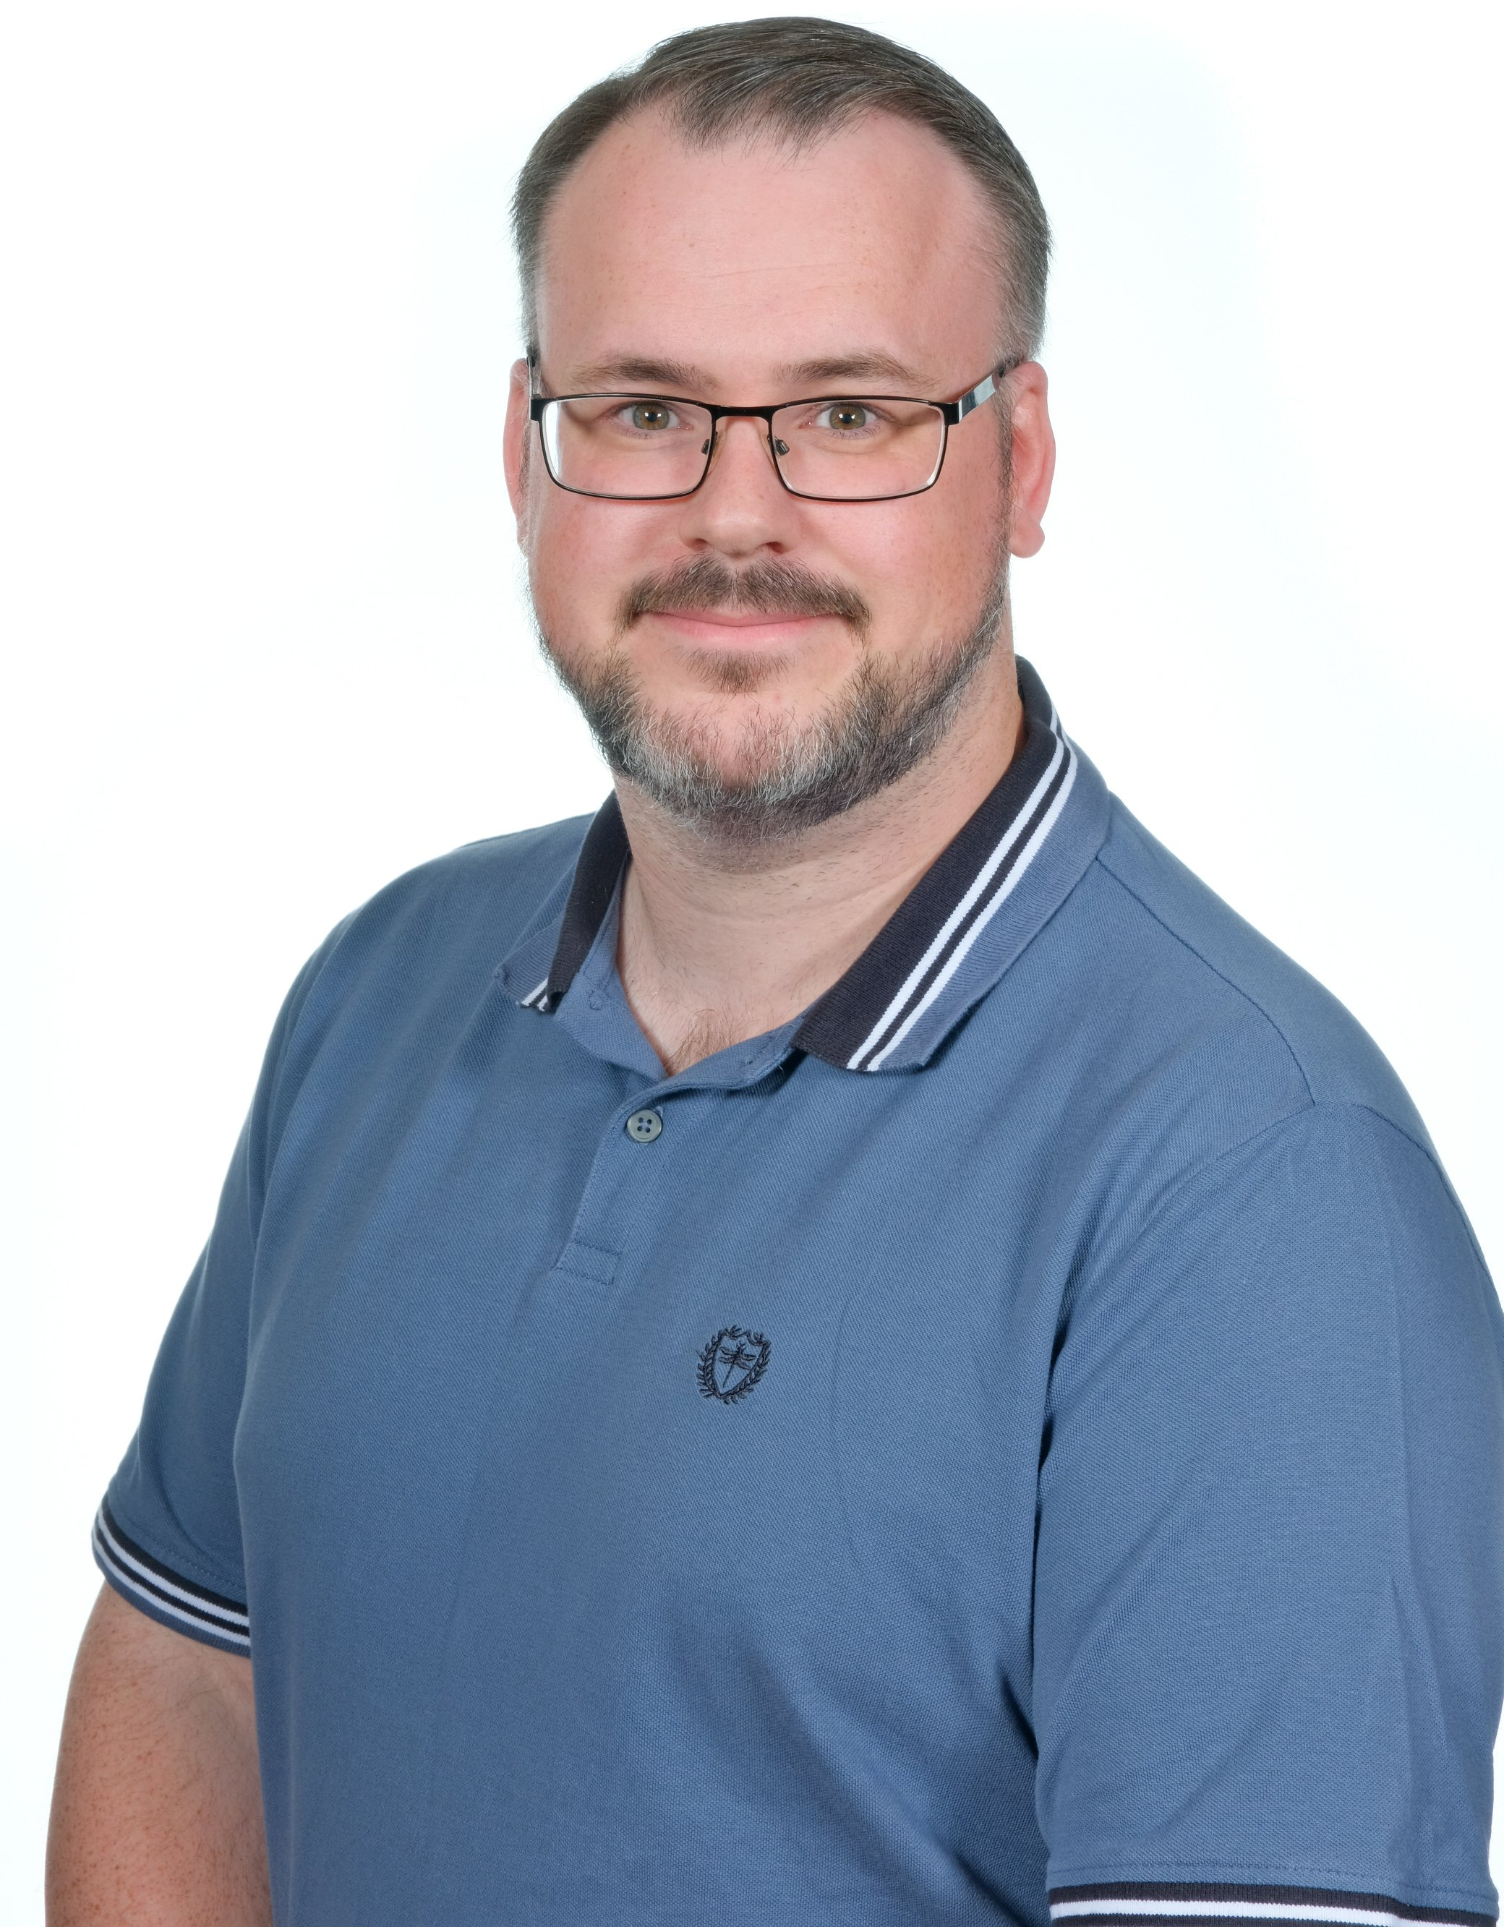
The KS1 Team
Miss Lounds (Y1) Mrs Henderson (Y1/2 & Assistant Headteacher) Miss Scrivener (SENCo&Y1/2) Mr Patten (Y2)

Slide 3
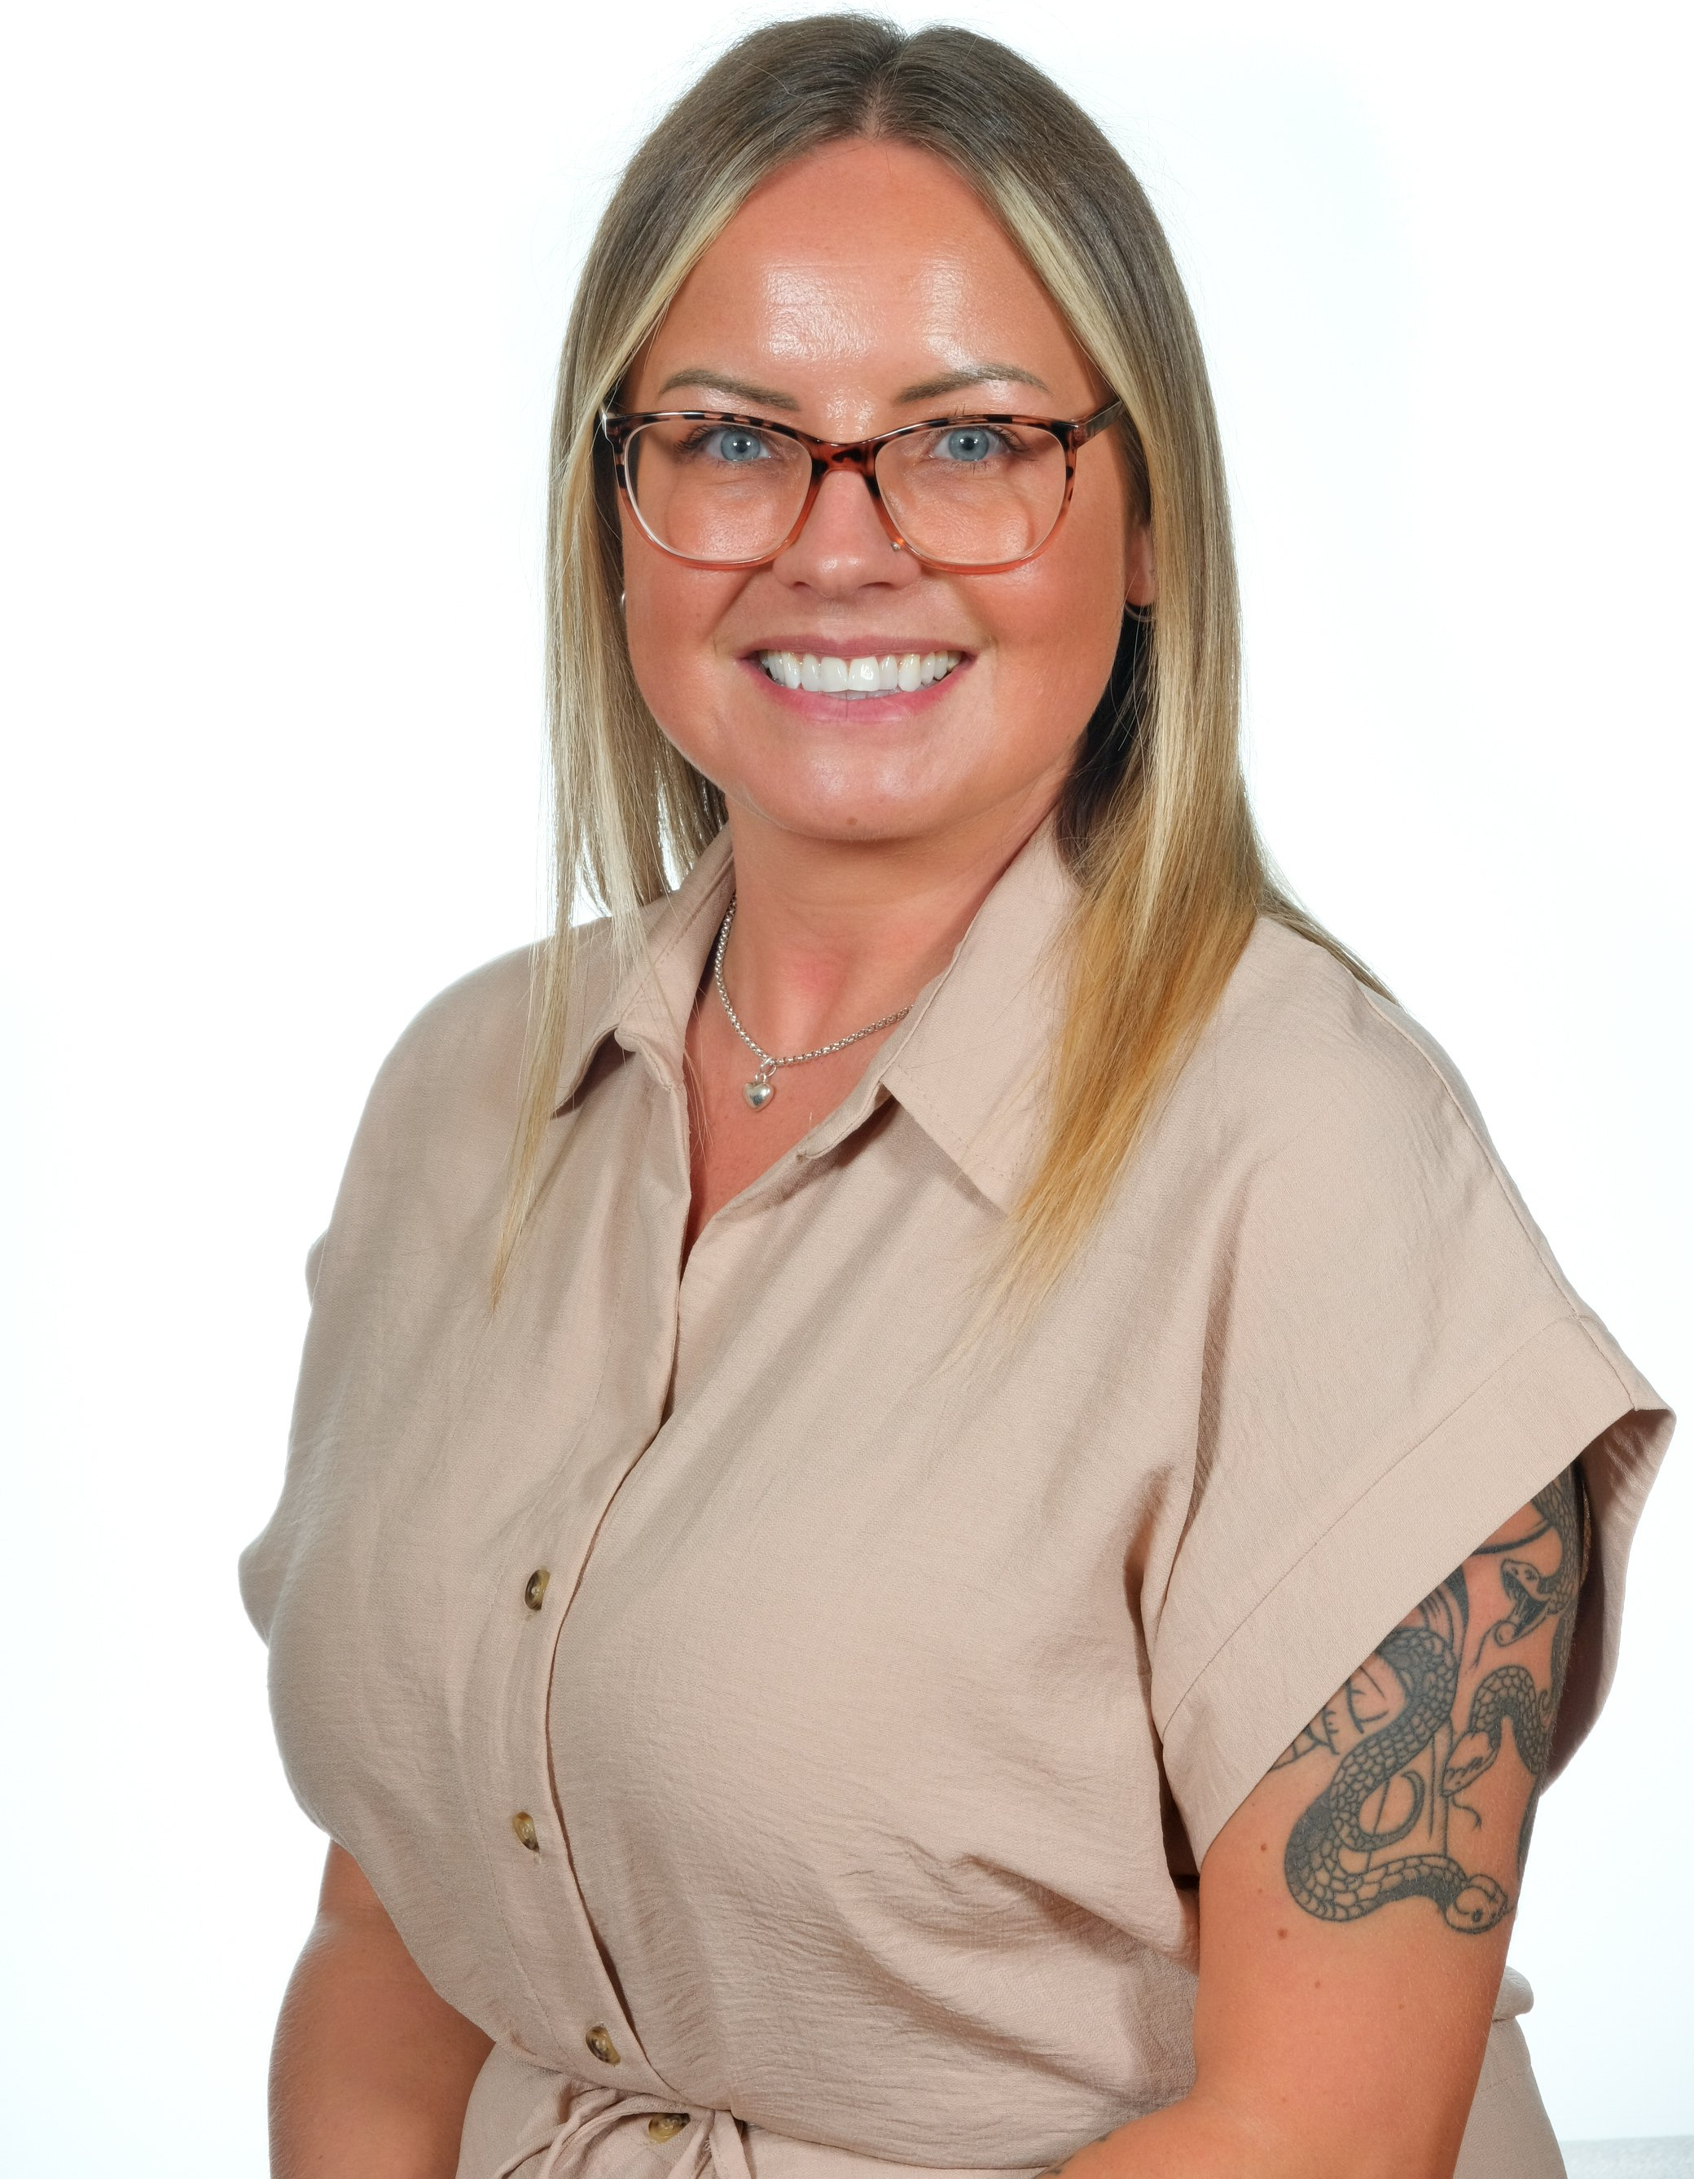
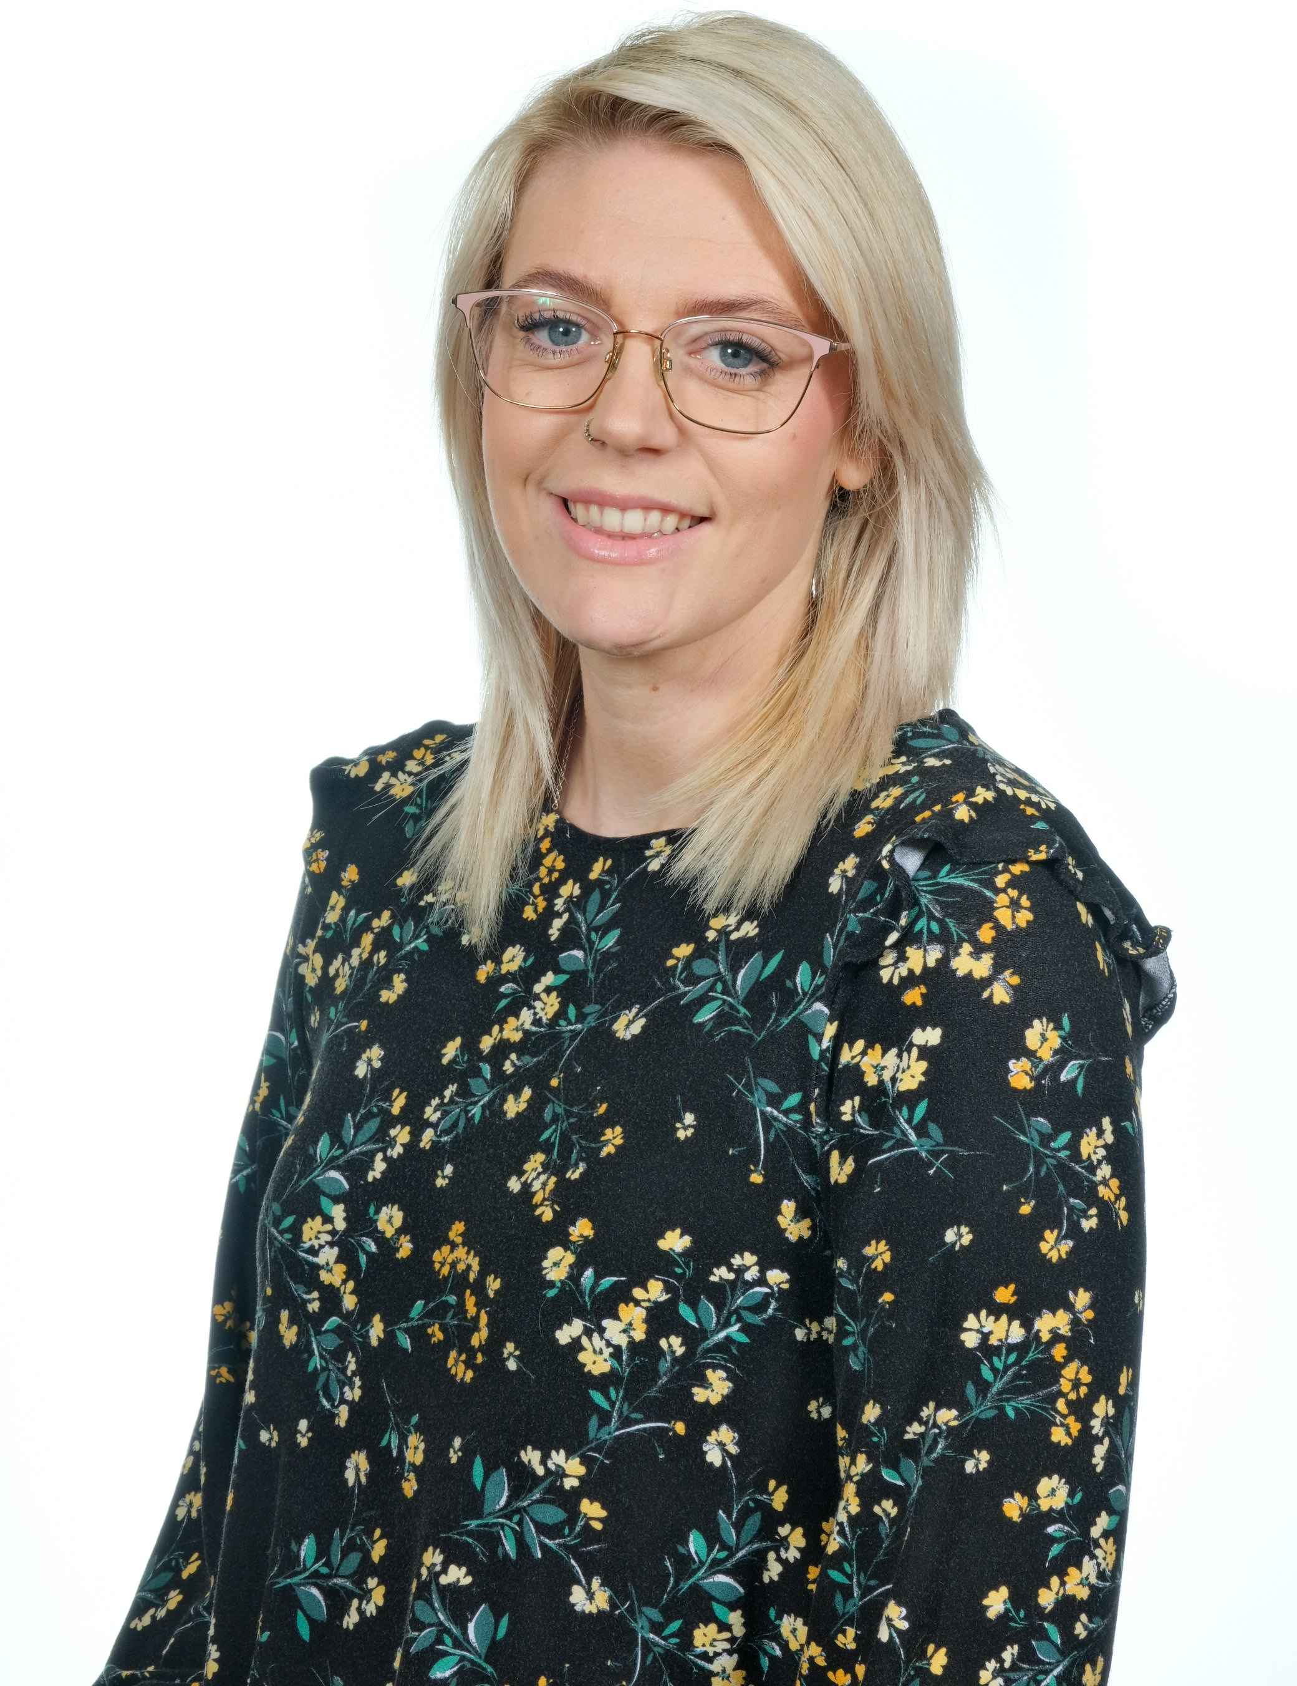
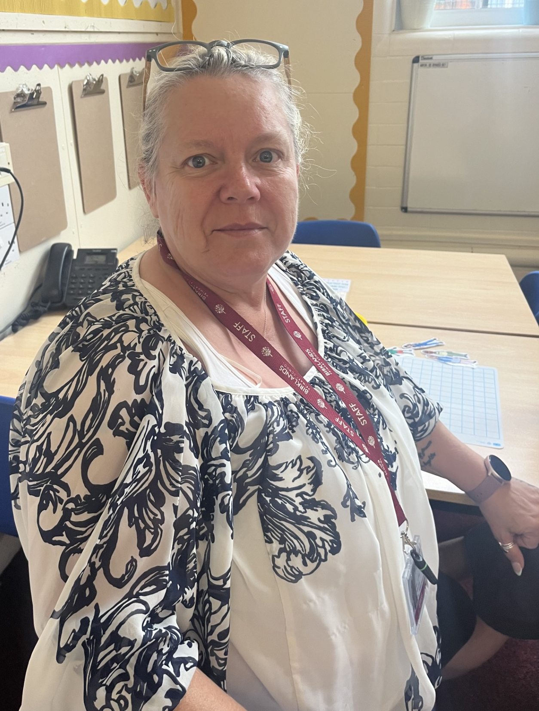
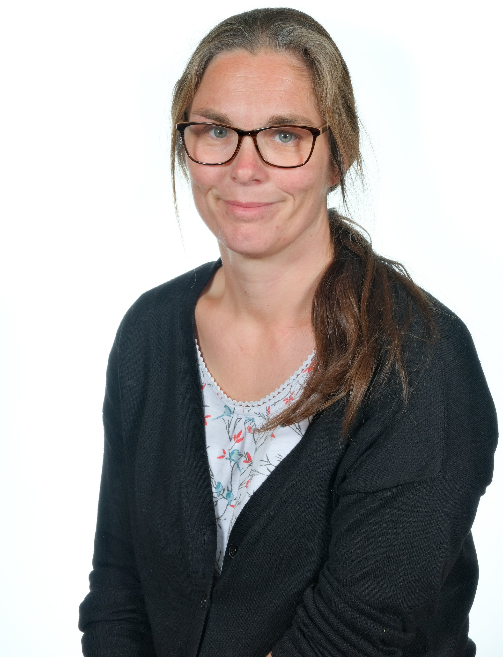
The KS1 Team
Mrs Peters Miss Ward Mrs Ward Miss Chambers

Slide 4
Curriculum in KS1
Autumn 1​ | Autumn 2​ | Spring 1​ | Spring 2​ | Summer 1​ | Summer 2​
The UK | Animals including humans Seasons | The Great Fire of London | Life in Spain Animals including humans | Living things and their habitats Seasons | Mary Seacole and Florence Nightingale
RE Day each half term
Sycamores enrichment
Visitors e.g. firefighters
Visit- TBC *Parent helpers

Slide 5
Dates to remember
Bring your grown up to school- Dove- Wednesday 11th December at 2:15pm
Y1 phonics meeting for parents- Tuesday 24th September at 2:30pm
KS1 nativity- Tuesday 3rd December at 9:30am, Wednesday 4th December at 1:30pm
Sycamores- Every other week this term, starting on Monday
Library visit: Friday 18th October

Slide 6
Uniform
White shirt or white / burgundy polo shirt ​
Burgundy cardigan / sweatshirt or fleece ​
Black or grey shorts, skirts, trousers or pinafore dresses burgundy gingham summer dresses ​
Black shoes - no trainers.​
​
​
Reminder of Mrs Farr letter regarding children attending in non-school uniform

Slide 7
PE
Thursday and Friday​
Thursday with the PE provider
Friday with Miss Scrivener
​
Uniform​
Black shorts / grey / black joggers ​
White / burgundy t-shirt (no logos),​
If hair is long, please tie it up​
Trainers
Earrings taken out wherever possible, if not, tape will be provided

Slide 8
Homework – Phonics and Reading
Reading x5 a week – remember to record this in diaries
Timestable rockstars logins
Support for parents | Letters and Sounds (littlewandlelettersandsounds.org.uk)

Slide 9
Collection at end of the day
Drop off and collection from the main KS1 door
Please wait until the end if you have any messages for us

Slide 10
Consequence ladder

Slide 11
Celebrations
Recognition Board & Stickers​
Celebration Assembly Friday – Be Kind & Working Hard​
​
Dove Of The Day​
Phone Call Home

Slide 12
Communication
Newsletter​
My Child in School app
​
Website​
​
Email addresses: jhenderson@birklandsschool.co.uk Dscrivener@birklandsschool.co.uk
​
Playground

Slide 13
Attendance
A big focus this year
Just a reminder of the importance of attending school each day
We will contact you / send your child home if they are unwell

Slide 14
Boosters
During the year, your child may be invited to a short booster before or after school

Slide 15
Reading books
Each child will have a reading book linked to their phonics and a 100 book (a book for pleasure)
Reading books and 100 books will be changed on a Monday and Tuesday each week

