Slide 2
Diving into Mastery Guidance for Educators
Each activity sheet is split into three sections, diving, deeper and deepest, which are represented by the following icons:
These carefully designed activities take your children through a learning journey, initially ensuring they are fluent with the key concept being taught; then applying this to a range of reasoning and problem-solving activities.
These sheets might not necessarily be used in a linear way. Some children might begin at the ‘Deeper’ section and in fact, others may ‘dive straight in’ to the ‘Deepest’ section if they have already mastered the skill and are applying this to show their depth of understanding.
Diving
Deeper
Deepest

Slide 3
Aim
Round any number to the nearest 10, 100 or 1000.

Slide 4
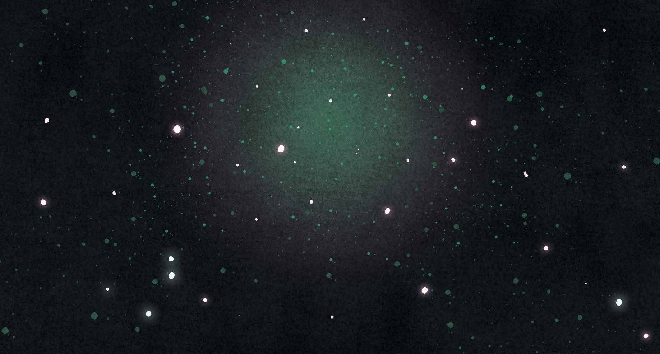
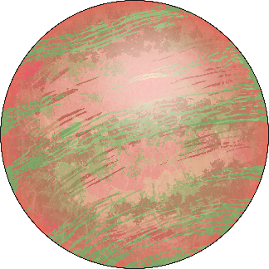
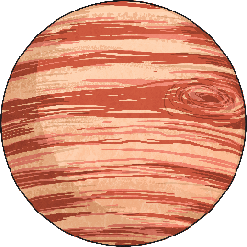
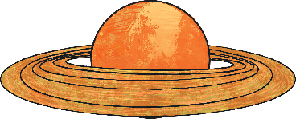
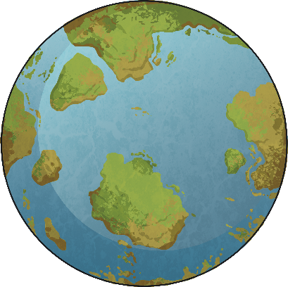
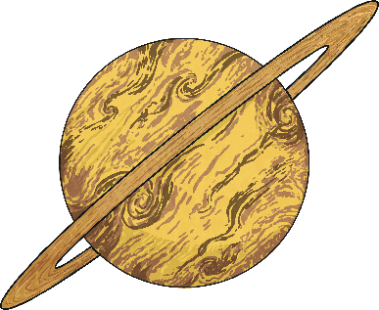
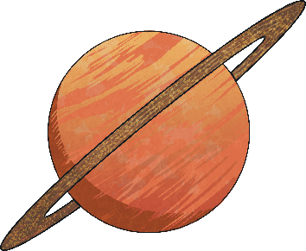
Rounding to the Nearest 10
Diving
Round each number to the nearest ten to match the comet to the correct planet.
310
280
300
300
320
290
294
317
321
304
286
305

Slide 5
Rounding to the Nearest 10
Deeper
Helen is checking the gauges on her control panel and rounding the readings to the nearest ten. Check her readings and correct any mistakes.
Can you explain any mistakes that she has made?
Rounded to the nearest ten, this reads 560.
Rounded to the nearest ten, this reads 600.
Rounded to the nearest ten, this reads 350.
Helen is incorrect. The gauge reads 565. As the ones digit is a 5, this should be rounded up to 570.
Helen is correct. 596 is between 590 and 600. As the ones digit is a six, the number is rounded up to 600.
Helen is incorrect. 362 is between 360 and 370. The number should be rounded down to 360, not to 350.
FUEL
OXYGEN
CO₂

Slide 6
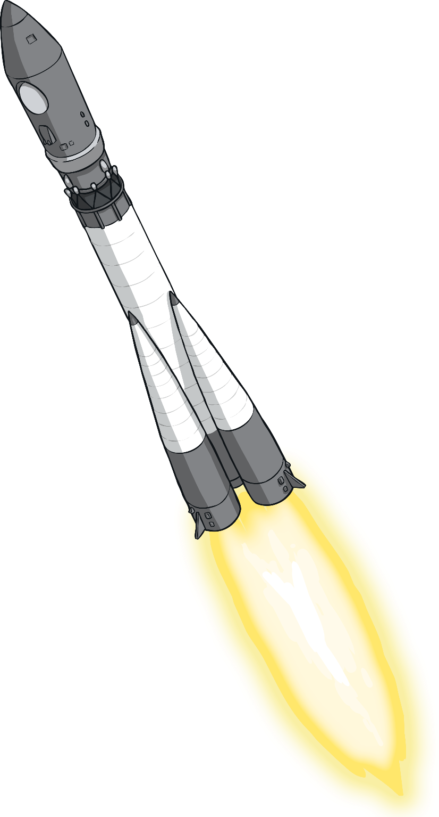
Rounding to the Nearest 10
Deepest
Read the clues below.
What could the number be on the side of the rocket?
It is a three-digit number that is less than 300.
When the number is rounded to the nearest ten, its digits are all even.
The tens digit is three times the hundreds digit.
It could be between 100 and 299.
It must be in the 200s. The tens digit could be 0, 2, 4, 6, or 8.
The tens digit must be 6 as this is three times 2. The rounded number is 260.
Find all the possible answers.
The rocket number rounds to 260. This means that it must be between 255 and 264. It could be 255, 256, 257, 258, 259, 260, 261, 262, 263 or 264.
???

Slide 7
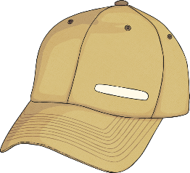
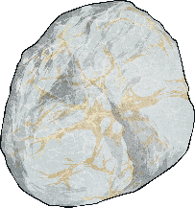
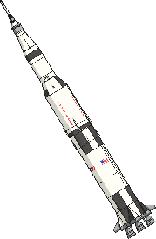
Rounding to the Nearest 10
Deepest
Look at the items for sale in the space museum shop.
Gloves
£12
Hat
£27
Badge
£8
Moon Rock
£39
Model Rocket
£12
Buzz wants to buy two items. He rounds the prices to the nearest £10 and finds that the rounded total of his two items is £70.
Which two items did he choose?
Is his rounded total greater or less than the actual total?
Buzz must have chosen a hat and moon rock, as these are the only two items with rounded costs adding up to £70.
The actual total cost of these is £66. This is less than the rounded total.

Slide 8
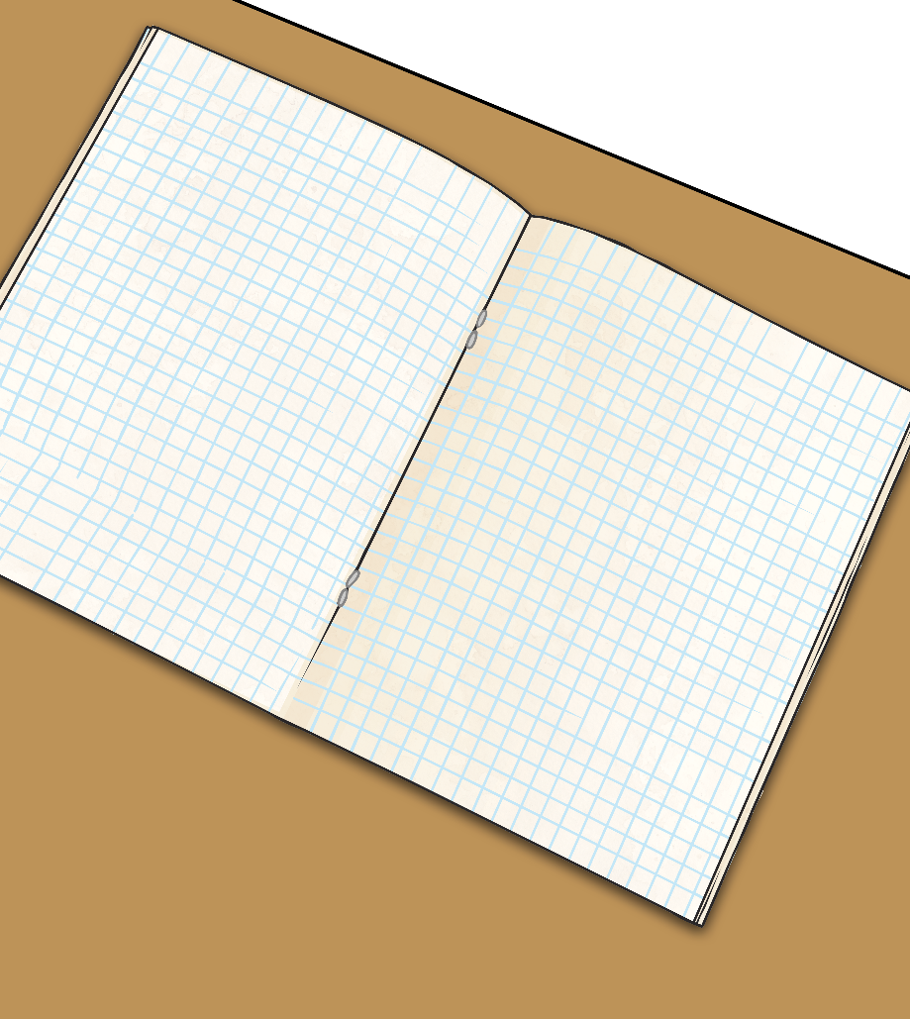
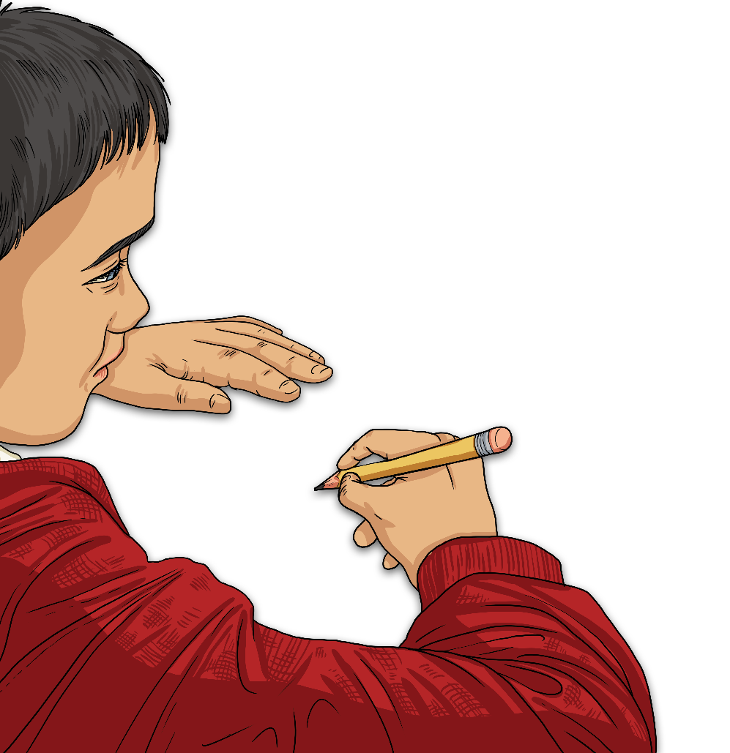
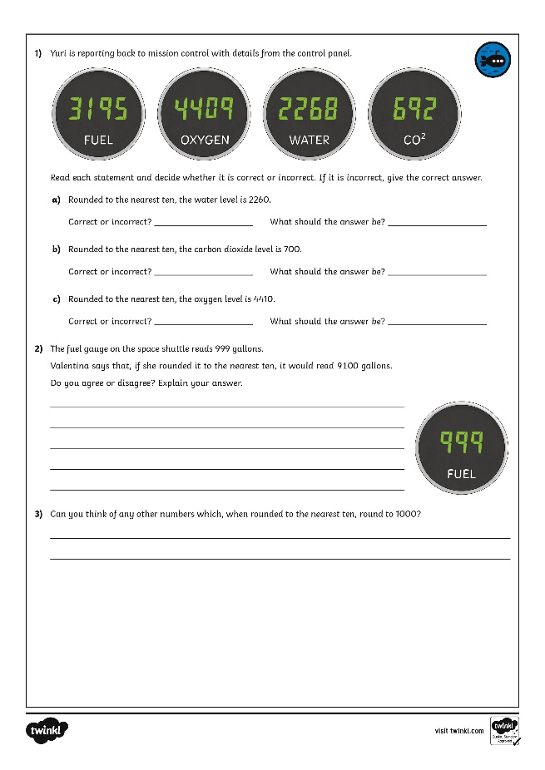
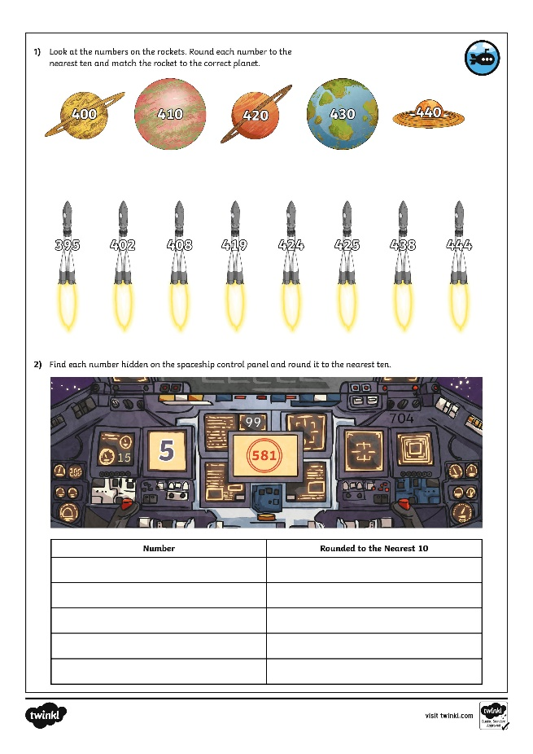
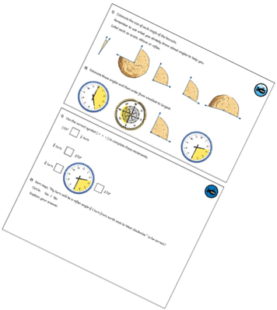
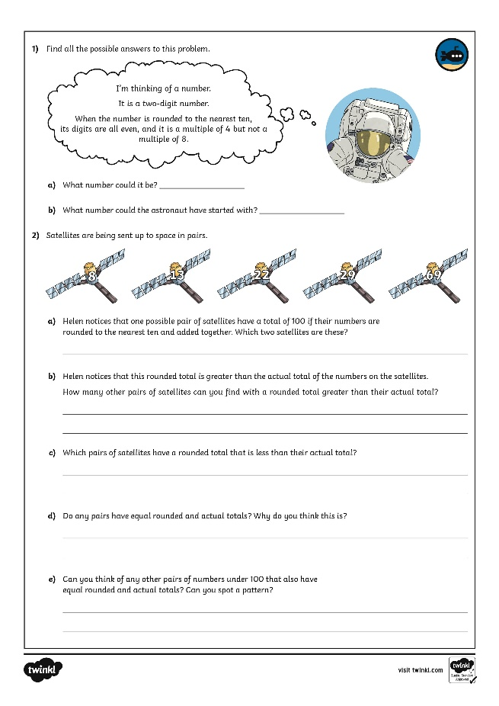
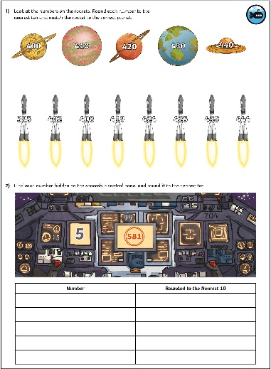
Rounding to the Nearest 10
Dive in by completing your own activity!

Slide 9
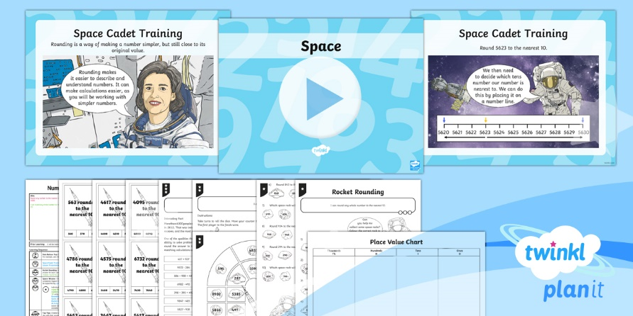
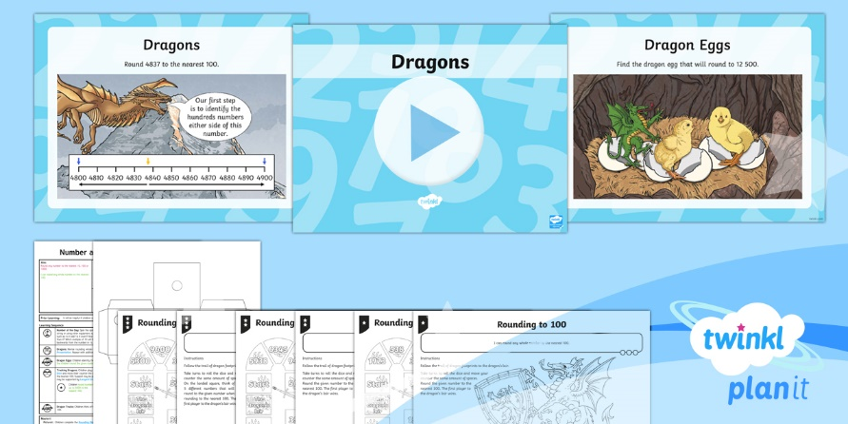
Need Planning to Complement this Resource?
National Curriculum Aim
Round any number to the nearest 10, 100 or 1000.
For more planning resources to support this aim, click here.
Twinkl PlanIt is our award-winning scheme of work with over 4000 resources.

