Slide 2
Diving into Mastery Guidance for Educators
Each activity sheet is split into three sections, diving, deeper and deepest, which are represented by the following icons:
These carefully designed activities take your children through a learning journey, initially ensuring they are fluent with the key concept being taught; then applying this to a range of reasoning and problem-solving activities.
These sheets might not necessarily be used in a linear way. Some children might begin at the ‘Deeper’ section and in fact, others may ‘dive straight in’ to the ‘Deepest’ section if they have already mastered the skill and are applying this to show their depth of understanding.
Diving
Deeper
Deepest

Slide 3
Aim
Find the perimeter of a shape on a cm grid.

Slide 4
Perimeter on a Grid
Diving
This shape has been drawn on a centimetre grid (not to scale).
Calculate the perimeter of the shape.
6cm + 6cm + 2cm + 2cm = 16cm
6cm
2cm
2cm
6cm

Slide 5
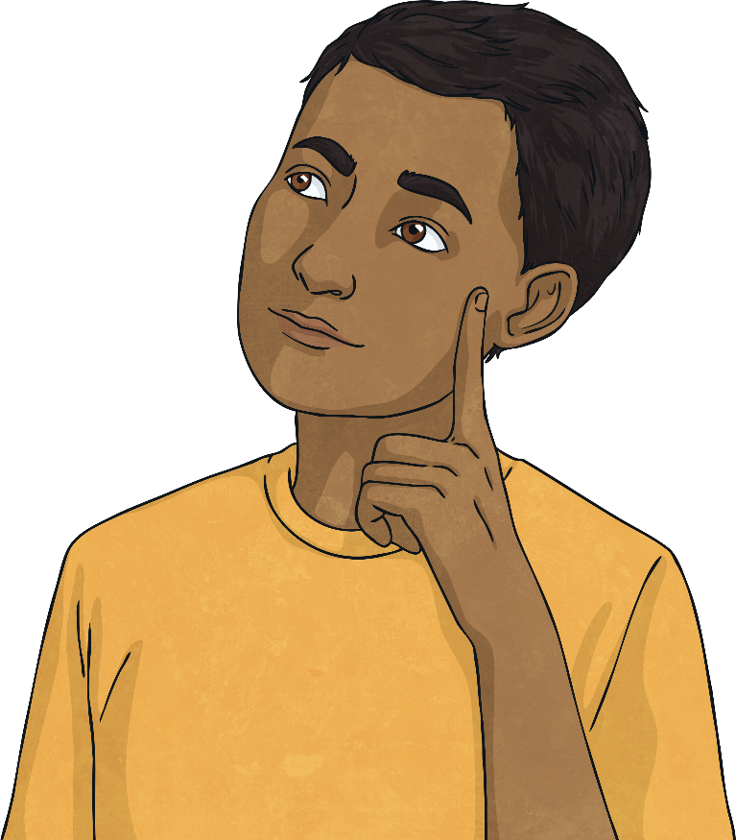
Perimeter on a Grid
Diving
These shapes both have a perimeter of 14cm.
Can you draw a different rectilinear shape that also has a perimeter of 14cm?
Did you and your partner find different shapes from each other? Why do you think this is?

Slide 6
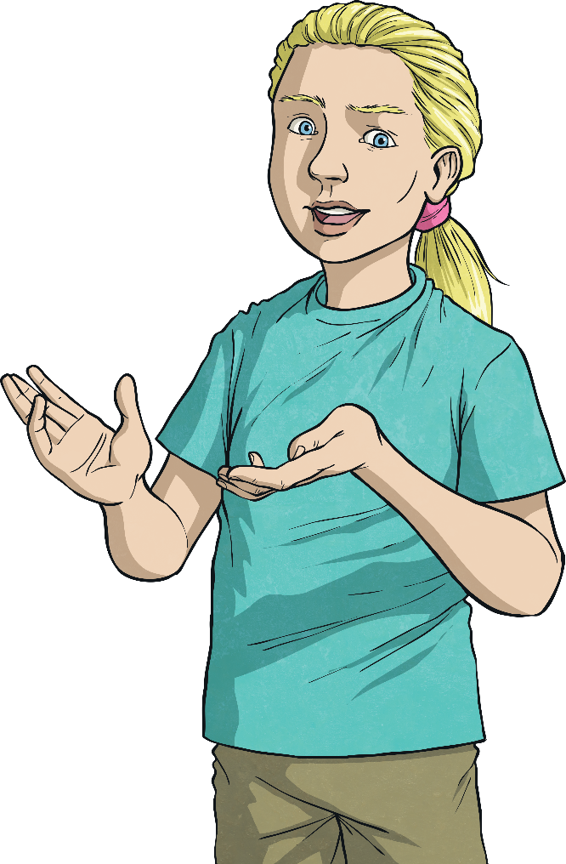
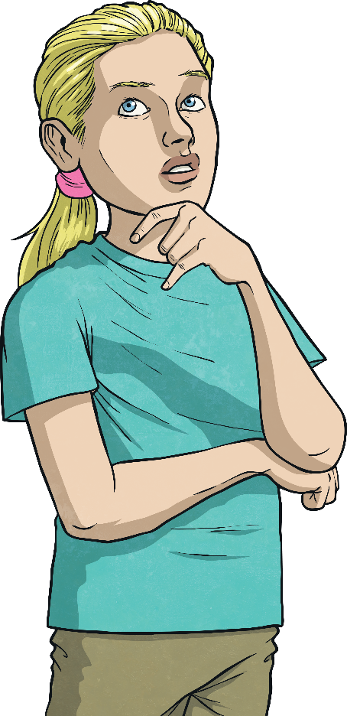
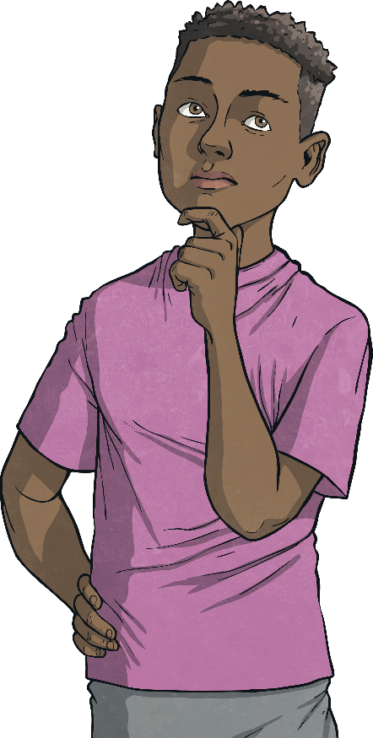
Perimeter on a Grid
Deeper
Which shape has the smallest perimeter?
Perimeter = 20cm
Perimeter = 18cm

Slide 7
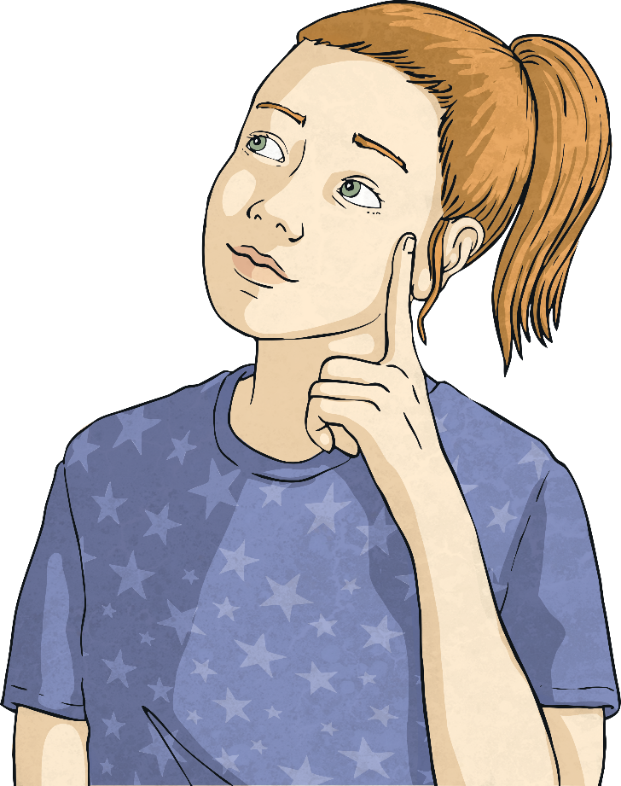
Perimeter on a Grid
Deeper
Claudia thinks that this shape has a perimeter of 20cm.
Can you tell what mistake she has made?
She has forgotten to count the inside edges of the missing squares.

Slide 8
Perimeter on a Grid
Deepest
Finn has 12 square mosaic tiles. Each side of each square is 1cm long.
His teacher has challenged him to make a shape where each square has at least one edge fully touching the edge of another square.
What is the longest perimeter that his shape could have?
26cm
What is the shortest perimeter that it could have?
14cm
Did you find more than one way of making the shape with the shortest perimeter? Why do you think this is?

Slide 9
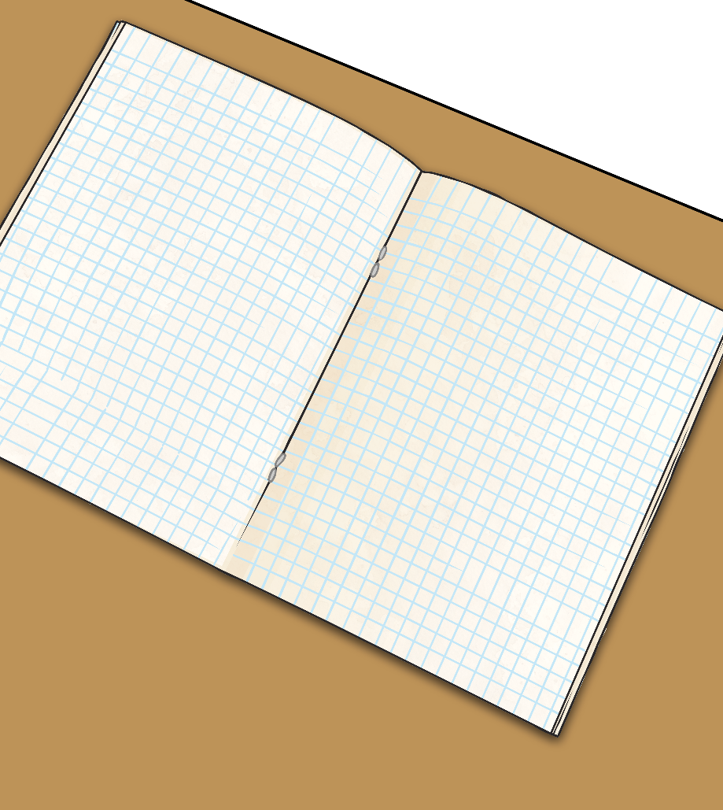
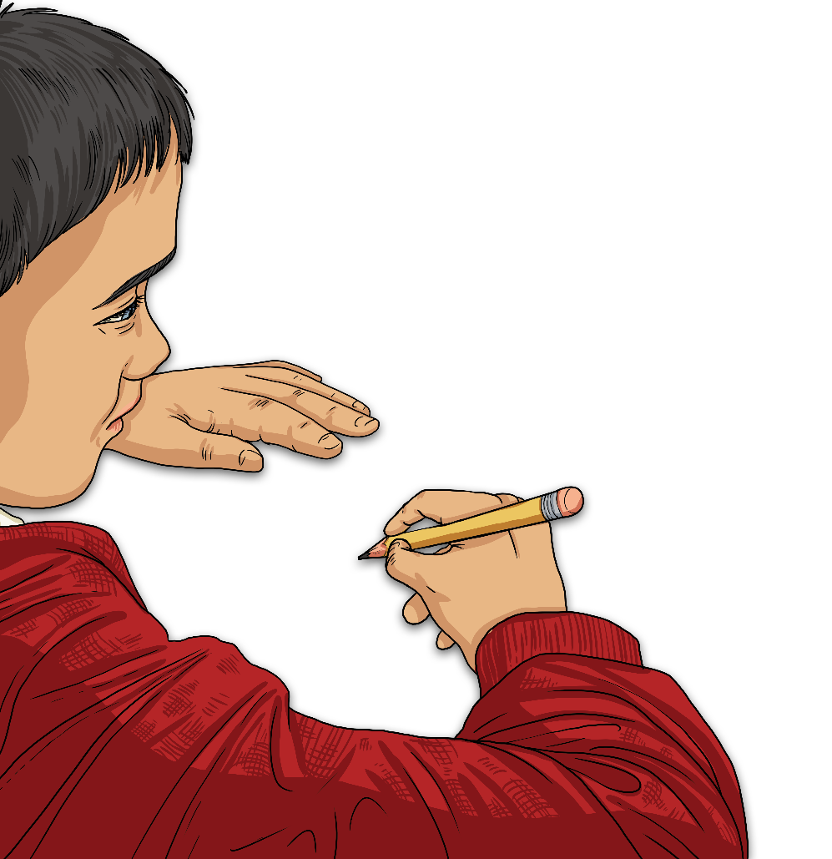
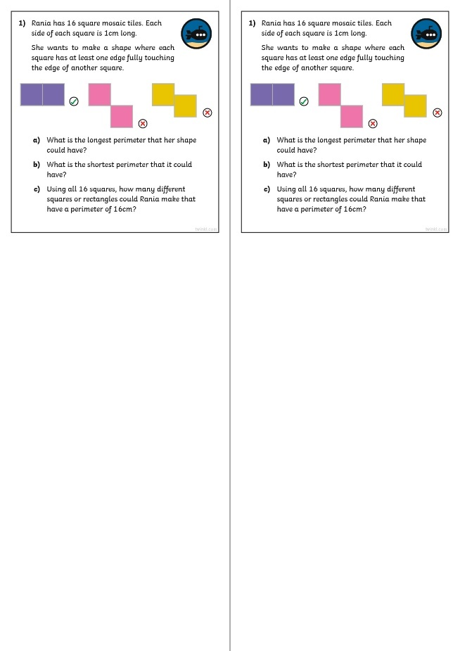
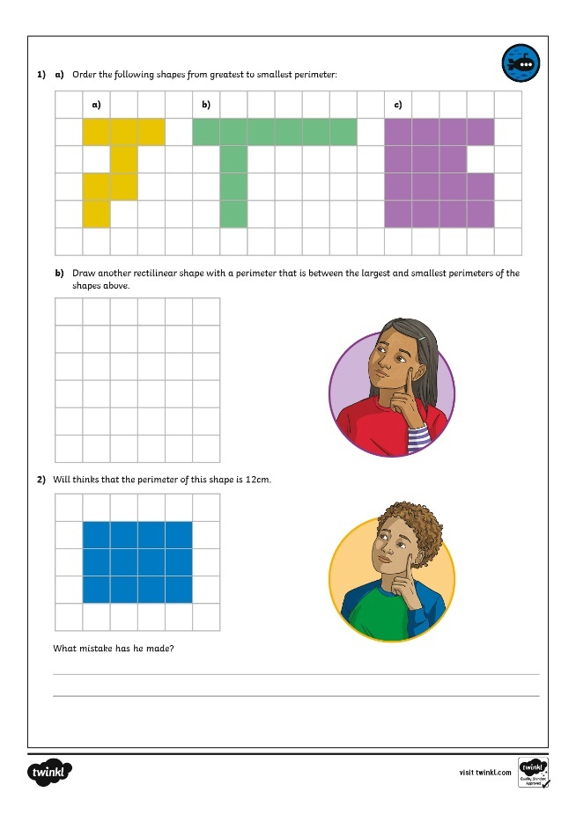
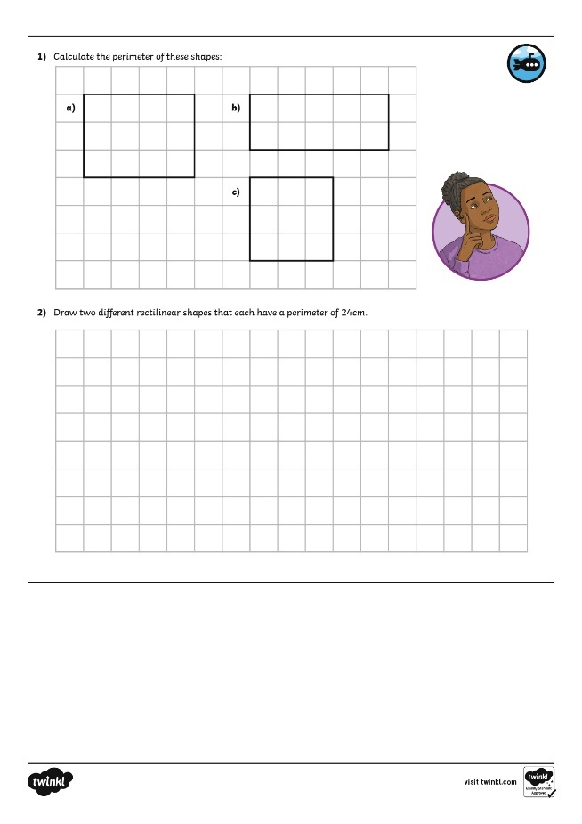
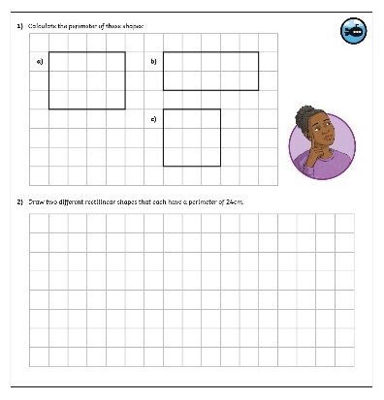
Perimeter on a Grid
Dive in by completing your own activity!

Slide 10
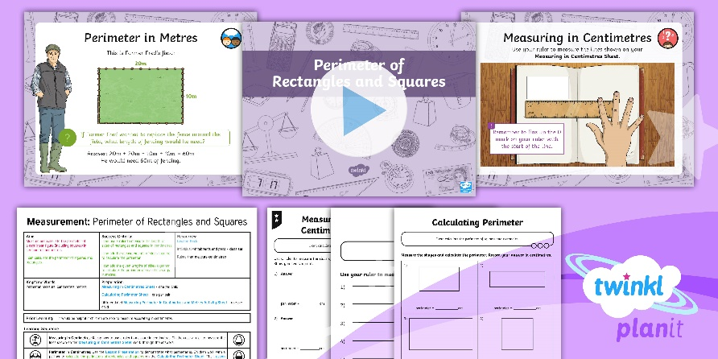
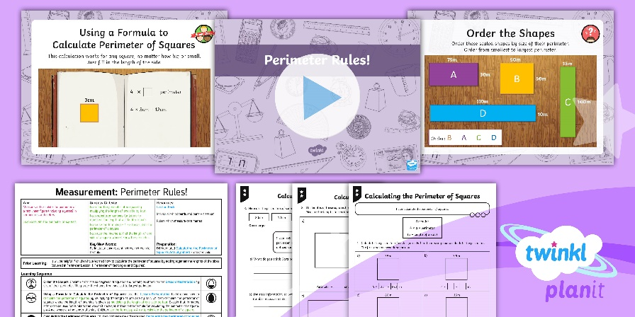
Need Planning to Complement this Resource?
National Curriculum Aim
Find the perimeter of a shape on a cm grid.
For more planning resources to support this aim, click here.
Twinkl PlanIt is our award-winning scheme of work with over 4000 resources.

