Slide 2
Diving into Mastery Guidance for Educators
Each activity sheet is split into three sections, diving, deeper and deepest, which are represented by the following icons:
These carefully designed activities take your children through a learning journey, initially ensuring they are fluent with the key concept being taught; then applying this to a range of reasoning and problem-solving activities.
These sheets might not necessarily be used in a linear way. Some children might begin at the ‘Deeper’ section and in fact, others may ‘dive straight in’ to the ‘Deepest’ section if they have already mastered the skill and are applying this to show their depth of understanding.
Diving
Deeper
Deepest

Slide 3
Aim
Measure and calculate the perimeter of a rectilinear figure (including squares) in centimetres and metres.

Slide 4
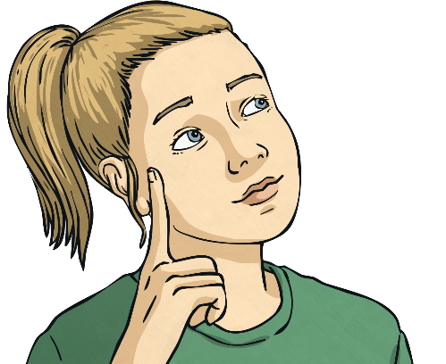
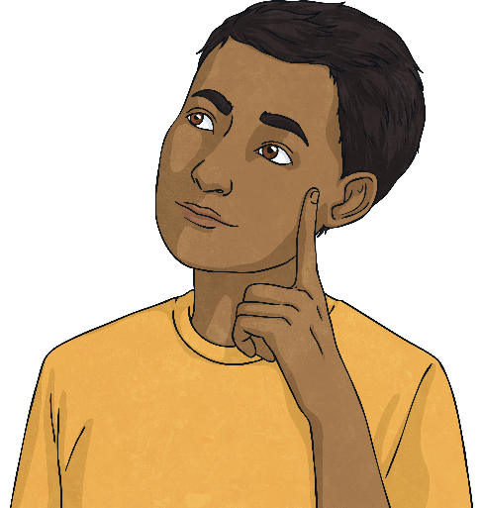
Perimeter of a Rectangle
Diving
Calculate the perimeter of each rectangle by adding the lengths of each side.
6cm
3cm
cm + cm + cm + cm = cm
6
6
3
3
18
3m
5m
m + m + m + m = m
5
5
3
3
16

Slide 5
Perimeter of a Rectangle
Diving
Calculate the perimeter of each rectangle by adding the length and width together and multiplying by 2.
3cm
6cm
4cm
5cm
4cm + 3cm = 7cm
7cm × 2 = 14cm
6cm + 5cm = 11cm
11cm × 2 = 22cm

Slide 6
Perimeter of a Rectangle
Deeper
Look at these calculations. Which are correct? Can you explain why? Can you explain the mistakes and find the correct answers?
6cm
7m
9cm
3m
6cm
5cm
7cm + 3cm = 10cm
10cm × 2 = 20cm
9cm + 5cm = 14cm
6cm × 4 = 24cm
This is correct. As the shape is a square, the perimeter can be calculated by multiplying the length of one side by four.
The incorrect units have been used – the measurements should be in metres.
The sum of the sides has not been doubled. The correct answer should be 28cm.

Slide 7
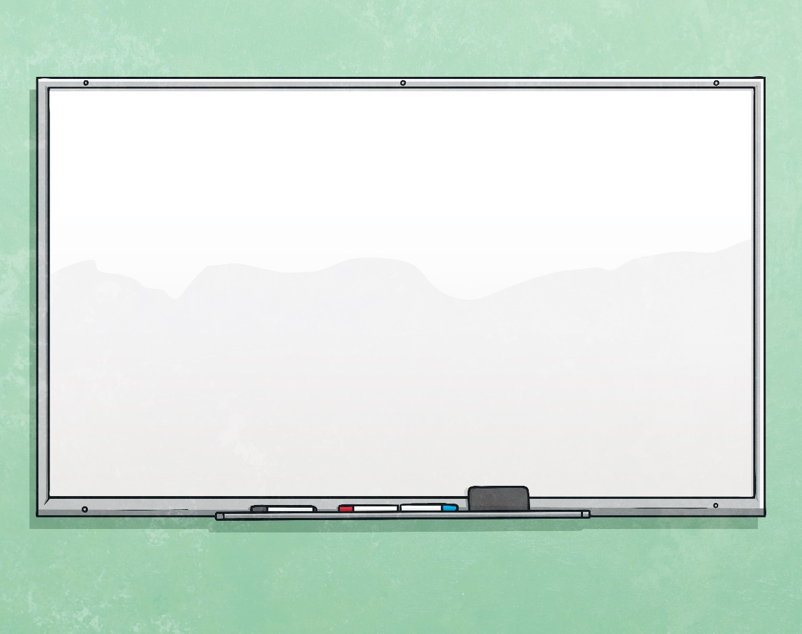
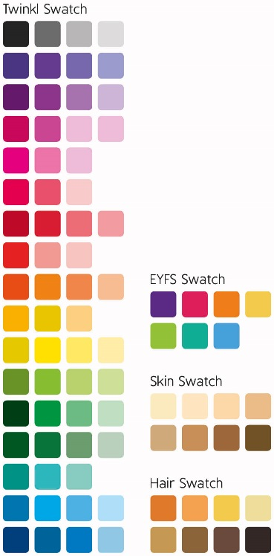
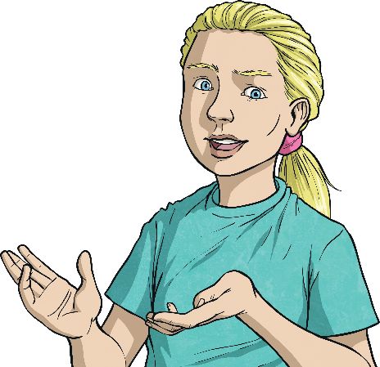
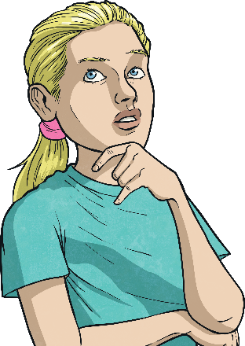
Perimeter of a Rectangle
Deeper
The perimeter of a rectangle is 20cm. One of the sides of the shape is 3cm.
What are the measurements of the other sides?
3cm + 3cm = 6cm
7cm
20cm – 6cm = 14cm
3cm
3cm
14cm ÷ 2 = 7cm
7cm

Slide 8
Perimeter of a Rectangle
Deepest
A rectangle has a perimeter of 18m. The length of each side is a whole number.
What could the length and the width of the rectangle be? Find all the possibilities.
The length and width must total 9m, as this is half of the perimeter.
Possible measurements are:
1m
2m
3m
4m
How could you have worked this out systematically to make sure you didn’t miss any of the answers?
8m
7m
6m
5m

Slide 9
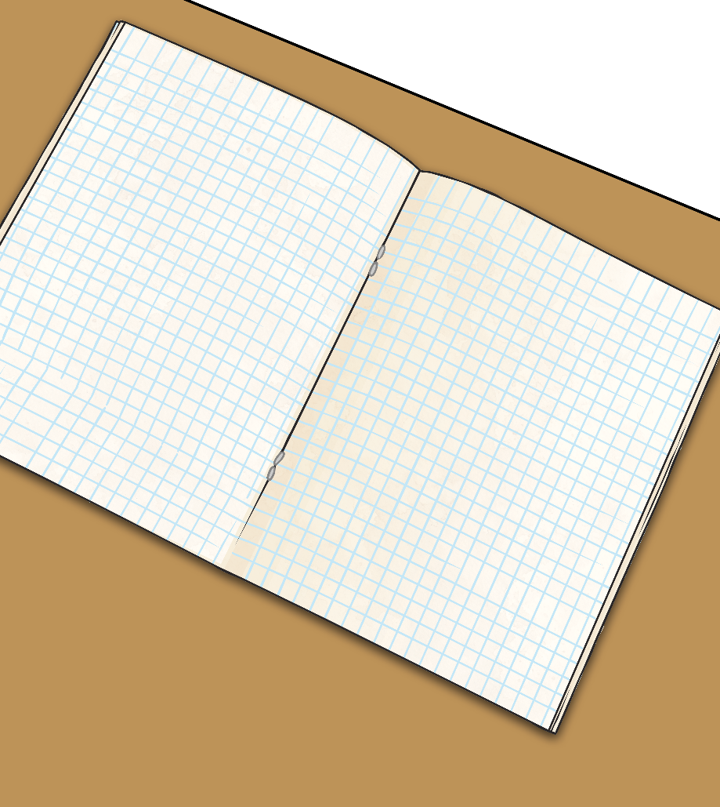
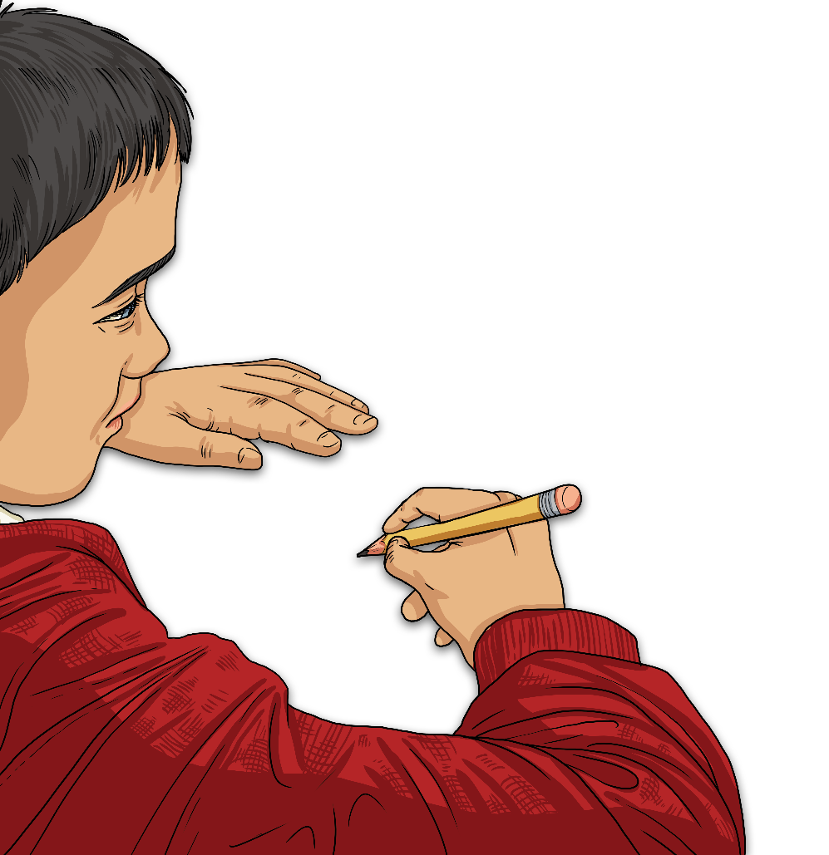
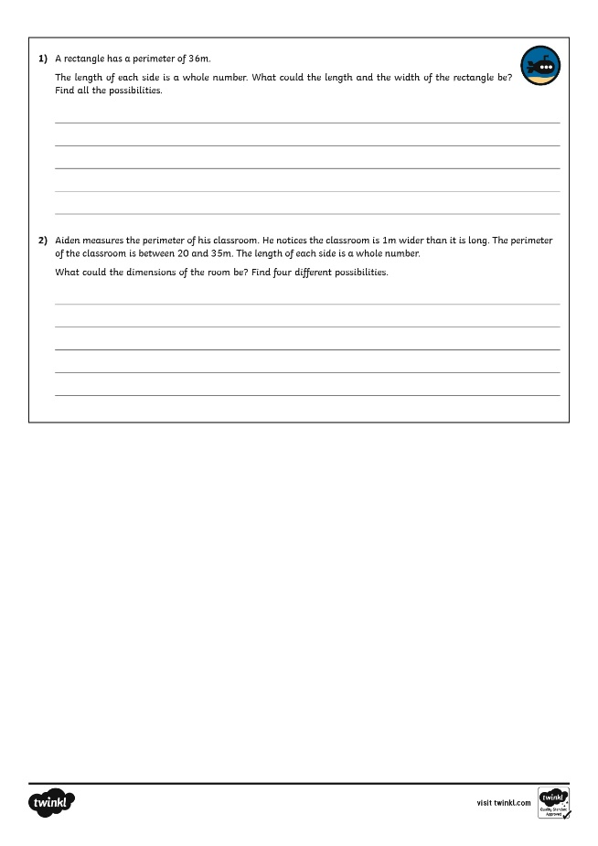
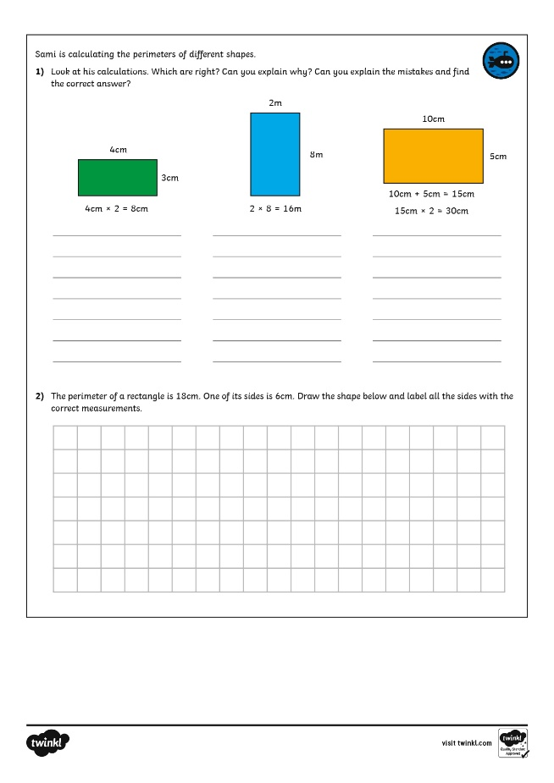
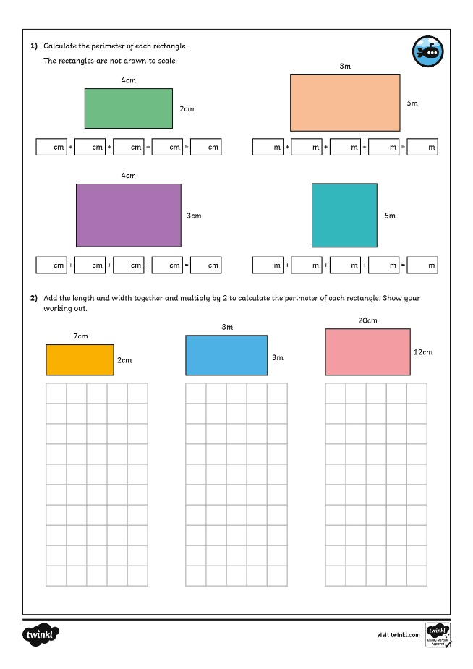
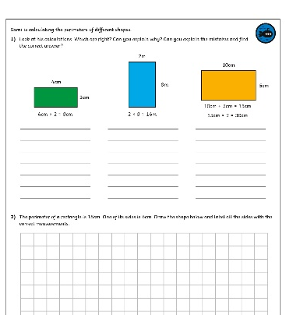
Perimeter of a Rectangle
Dive in by completing your own activity!

Slide 10
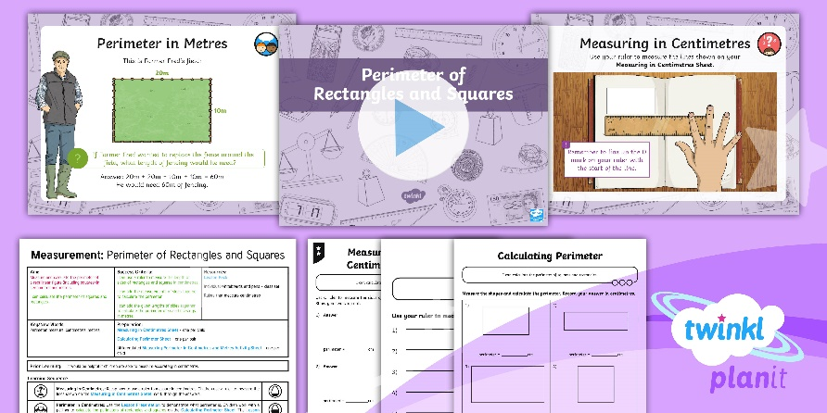
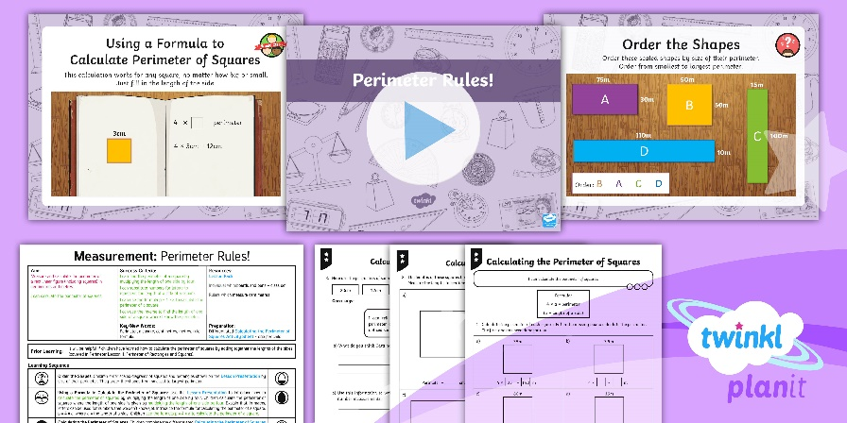
Need Planning to Complement this Resource?
National Curriculum Aim
Measure and calculate the perimeter of a rectilinear figure in centimetres and metres.
For more planning resources to support this aim, click here.
Twinkl PlanIt is our award-winning scheme of work with over 4000 resources.

