Slide 2
Diving into Mastery Guidance for Educators
Each activity sheet is split into three sections, diving, deeper and deepest, which are represented by the following icons:
These carefully designed activities take your children through a learning journey, initially ensuring they are fluent with the key concept being taught; then applying this to a range of reasoning and problem-solving activities.
These sheets might not necessarily be used in a linear way. Some children might begin at the ‘Deeper’ section and in fact, others may ‘dive straight in’ to the ‘Deepest’ section if they have already mastered the skill and are applying this to show their depth of understanding.
Diving
Deeper
Deepest

Slide 3
Aim
Add and subtract numbers with up to 4 digits using the formal written methods of columnar addition and subtraction where appropriate.

Slide 4
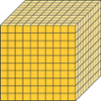
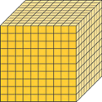
Add Two 4-Digit Numbers - More Than One Exchange
Diving
Use the representations in the treasure chests to help you solve these calculations.
8004
9631
4385 + 3619 =
5382 + 4249 =
4323
2864 + 1459 =
TH | H | T | O
?
5382 | 4249

Slide 5
Add Two 4-Digit Numbers - More Than One Exchange
Diving
How many coins are in each bag?
 | 4 | 9 | 3 | 7
+ | 1 | 2 | 9 | 6
 | 2 | 6 | 3 | 8
+ | 1 | 7 | 2 | 9
6
2
3
3
4
3
6
7
1
1
1
1
1

Slide 6
Add Two 4-Digit Numbers - More Than One Exchange
Deeper
Pirate Swashbuckle has completed a calculation.
Explain and correct the errors in his calculation:
 | 5 | 9 | 6 | 6
+ | 3 | 6 | 2 | 4
 | 8 | 15 | 8 | 0
1
The 10 ones regrouped as 1 ten have not been included in the addition in the tens column.
15 hundreds have been written in the answer space in the hundreds column. These should have been regrouped as 1 thousand and 5 hundreds. The answer should be 9590.

Slide 7
Add Two 4-Digit Numbers - More Than One Exchange
Deepest
How many different ways can you find to complete the calculation correctly?
 | 6 | 3 |  | 4
+ | 3 | 4 |  | 9
 | 9 | 8 | 6 | 3
1
1
The answer in the tens column needs to total 16 tens. 1 ten has been regrouped from the ones column so the 2 tens digits need to total 15 tens. The digits could be 9 and 6 or 8 and 7 so four different calculations are possible. These are 6394 + 3469, 6364 + 3499, 6384 + 3479, 6374 + 3489.

Slide 8
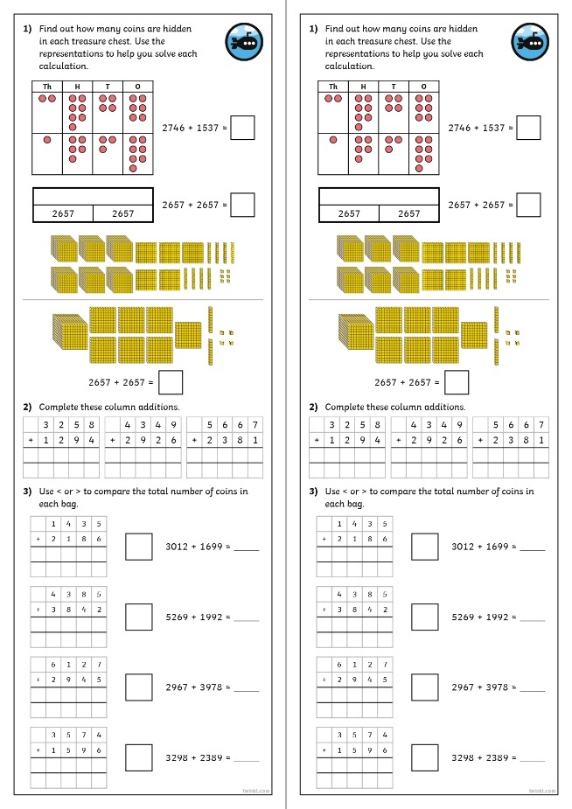
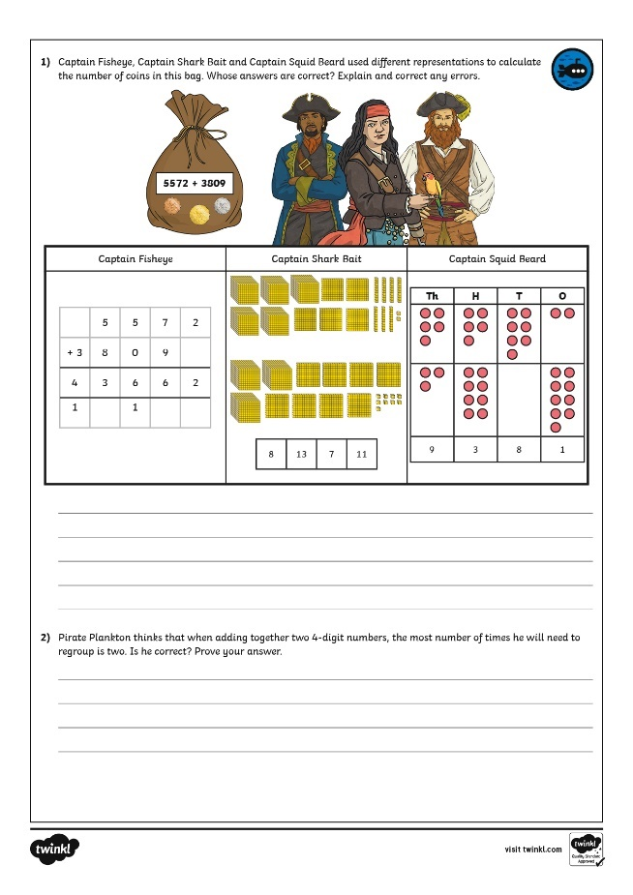
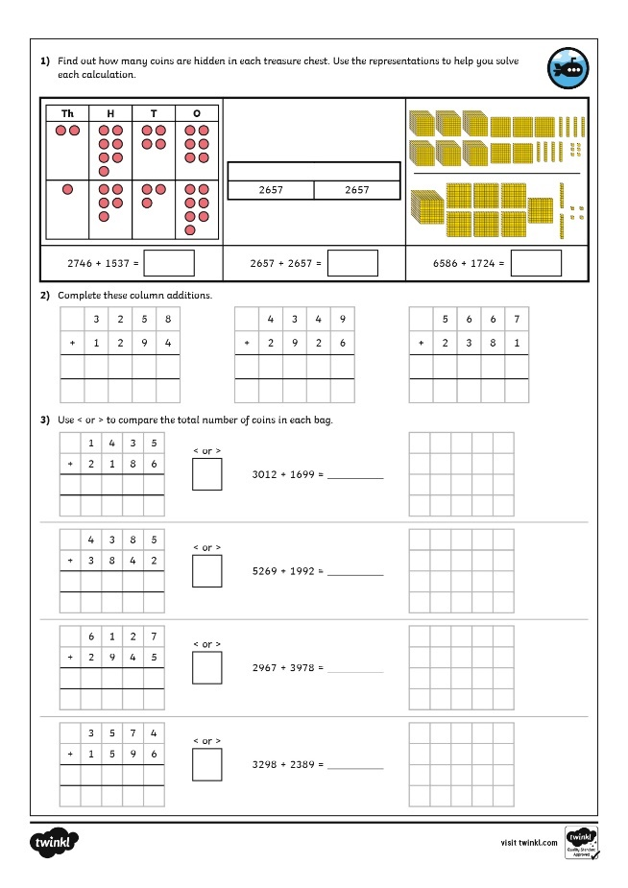
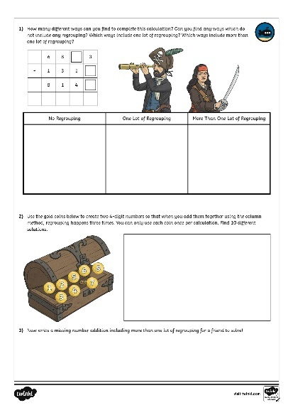
Add Two 4-Digit Numbers - More Than One Exchange
Dive in by completing your own activity!

Slide 9
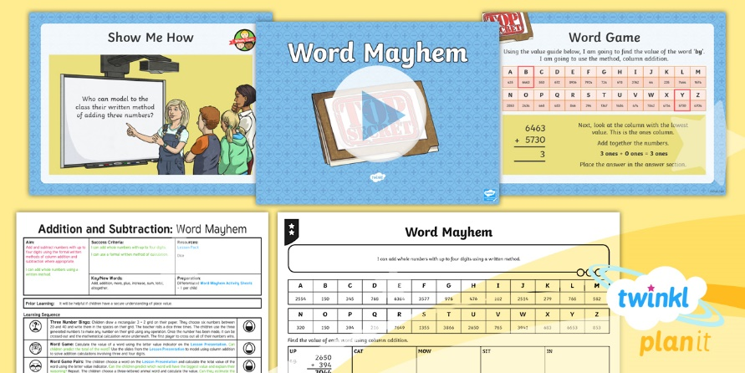
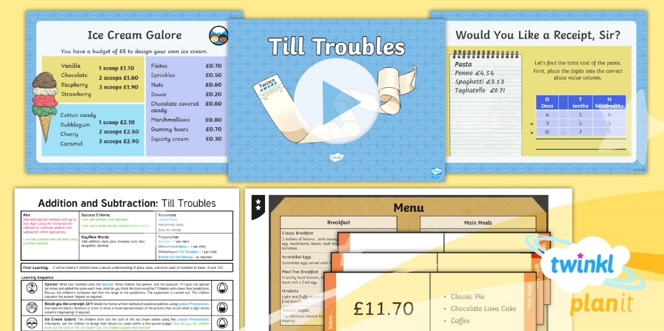
Need Planning to Complement this Resource?
National Curriculum Aim
Add and subtract numbers with up to 4 digits using the formal written methods of columnar addition and subtraction where appropriate
For more planning resources to support this aim, click here.
Twinkl PlanIt is our award-winning scheme of work with over 4000 resources.

