Slide 2
Diving into Mastery Guidance for Educators
Each activity sheet is split into three sections, diving, deeper and deepest, which are represented by the following icons:
These carefully designed activities take your children through a learning journey, initially ensuring they are fluent with the key concept being taught; then applying this to a range of reasoning and problem-solving activities.
These sheets might not necessarily be used in a linear way. Some children might begin at the ‘Deeper’ section and in fact, others may ‘dive straight in’ to the ‘Deepest’ section if they have already mastered the skill and are applying this to show their depth of understanding.
Diving
Deeper
Deepest

Slide 3
Aim
Round any number to the nearest 10, 100 or 1000.

Slide 4
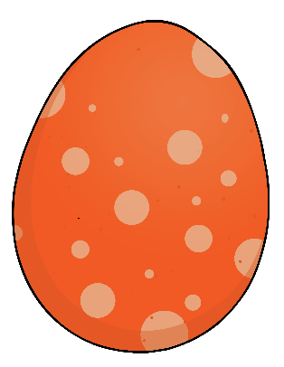
Rounding to the Nearest 100
Diving
Match each dragon egg to its correct position on the number line.
407
400
460
481
495
429
400
500

Slide 5
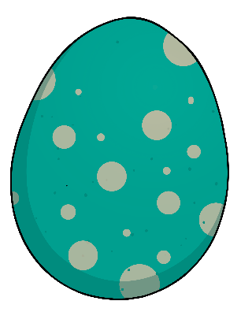
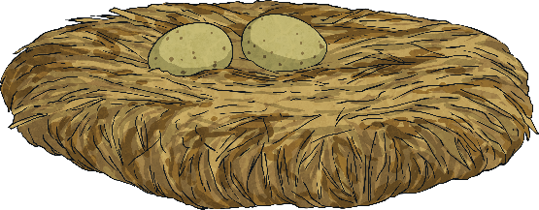
Rounding to the Nearest 100
Diving
Now round each number to the nearest hundred to sort each egg into the correct nest.
407
400
460
481
495
429
400
500

Slide 6
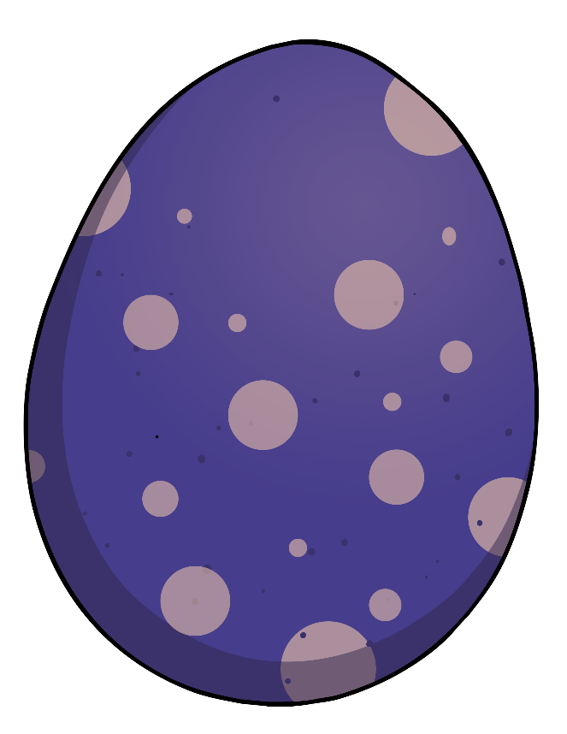
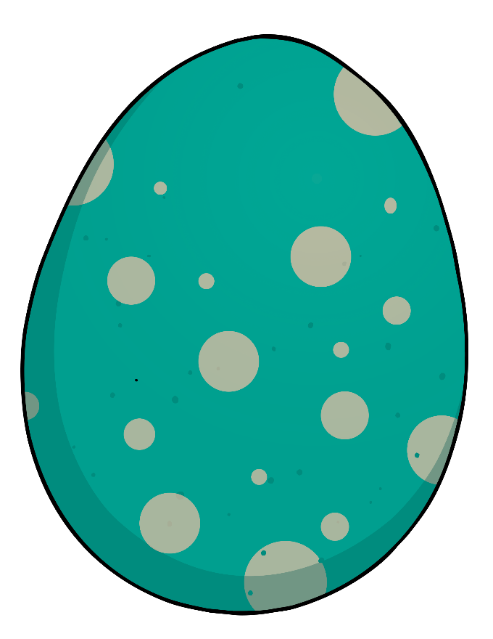
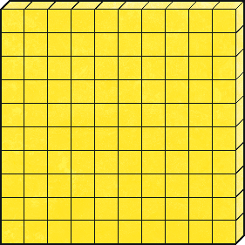
Rounding to the Nearest 100
Diving
Look at the number represented in each dragon egg and round it to the nearest hundred.
100
100
969
10
10
10
10
10
1000
200
300

Slide 7
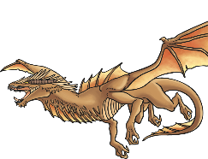
Rounding to the Nearest 100
Deeper
The Winged Warrior
Look at the information card about the Winged Warrior’s weekly diet.
Which statements are correct? Explain your answer.
Locusts: 8389 Lizards: 1804 Water: 650 litres
1
Rounded to the nearest hundred, the number of locusts she eats is 8400.
This is correct. 8389 is closer to 8400 than 8300.
2
Rounded to the nearest hundred, the number of lizards she eats is 1700.
This is incorrect. The number should be rounded down to 1800. When rounding down to the nearest hundred, the hundreds digit should not change.
3
Rounded to the nearest hundred, the volume of water she drinks is 600 litres.
This is incorrect. 650 is halfway between 600 and 700. When the tens digit is a 5, the number is rounded up not down. The answer should be 700.

Slide 8
Rounding to the Nearest 100
Deepest
A survey of the nests in Camelot Valley found 700 dragon eggs, when the number was rounded to the nearest hundred.
How many eggs could there have been in the valley? Explain how you know.
The smallest possible number of eggs is 650, as this is the smallest number that rounds up to 700.
The greatest possible number of eggs is 749, as this is the greatest number that rounds down to 700.
Any number in between 650 and 749 would also round to 700 – so any number between 650 and 749 is correct.

Slide 9
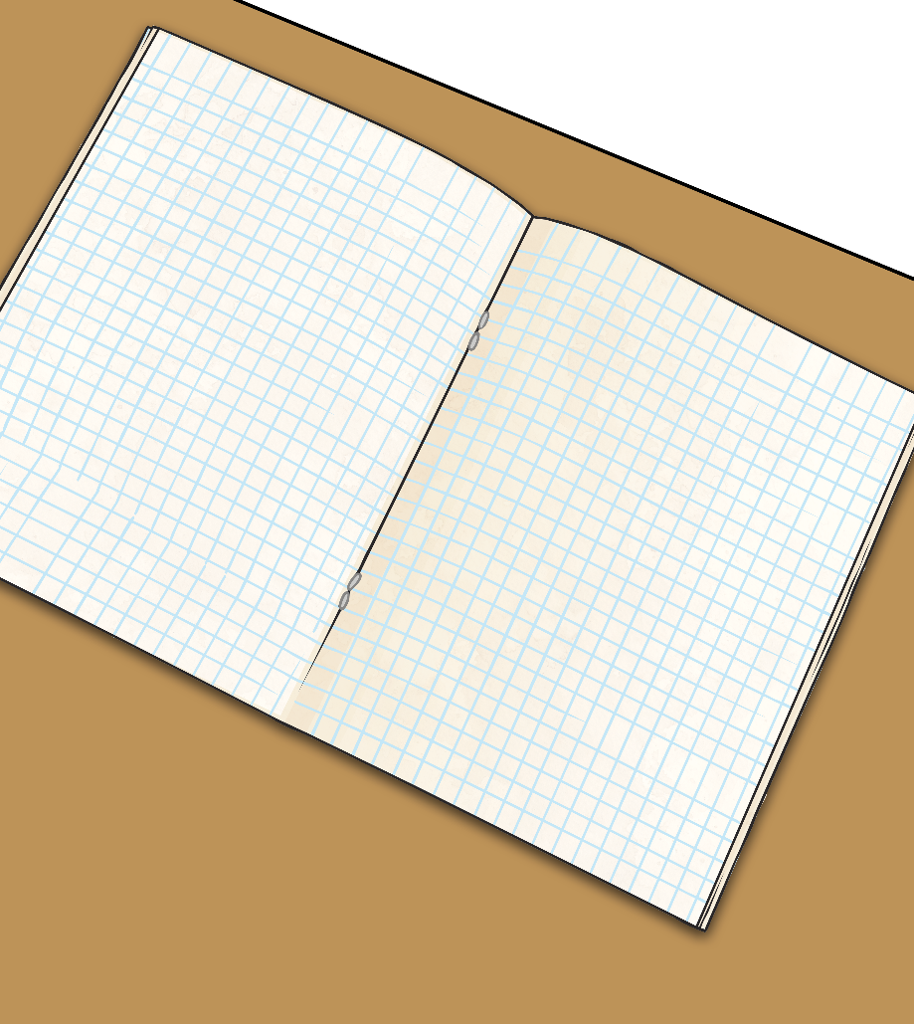
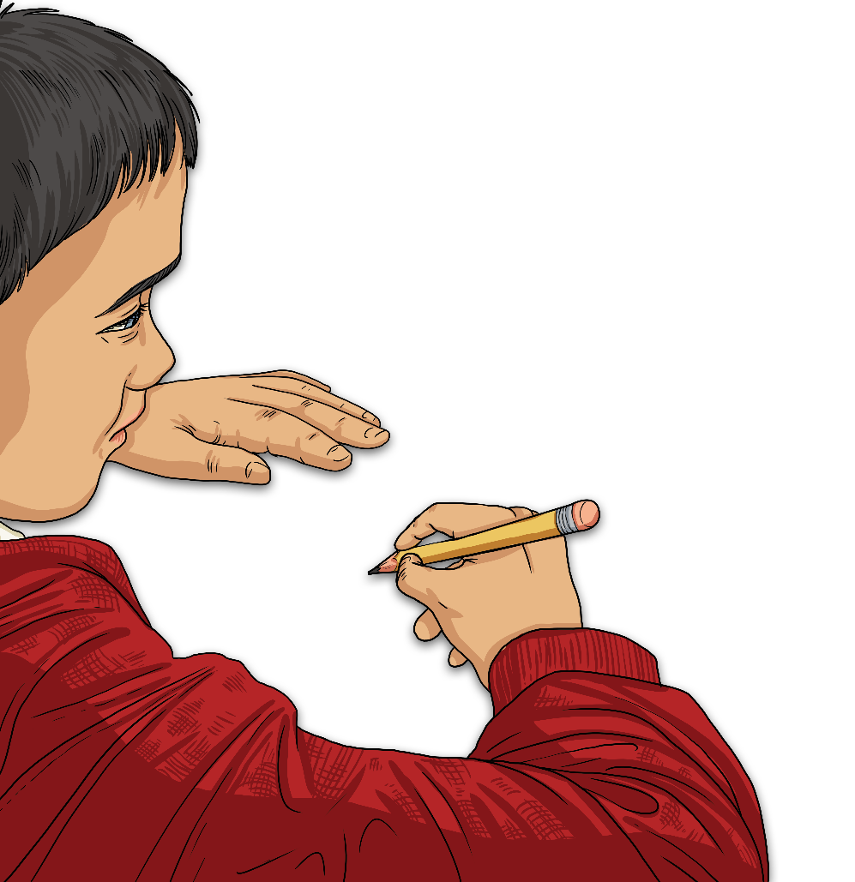
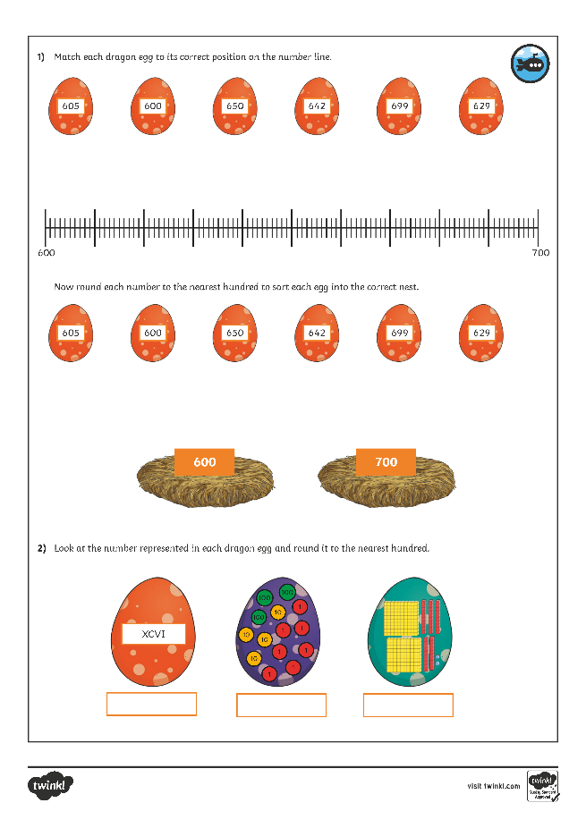
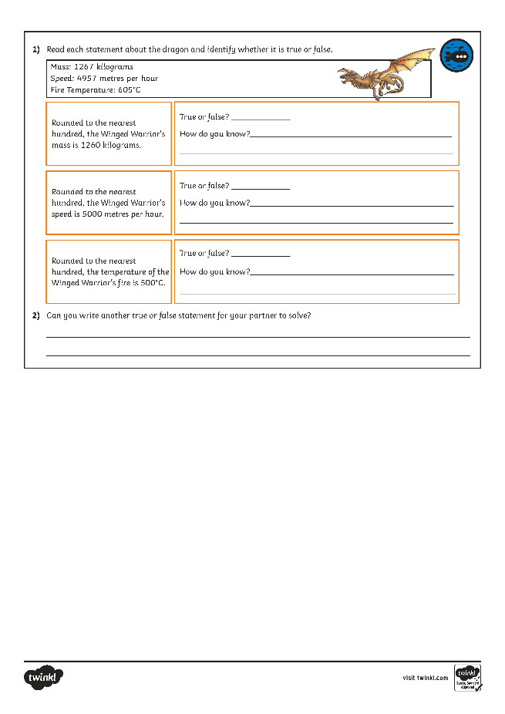
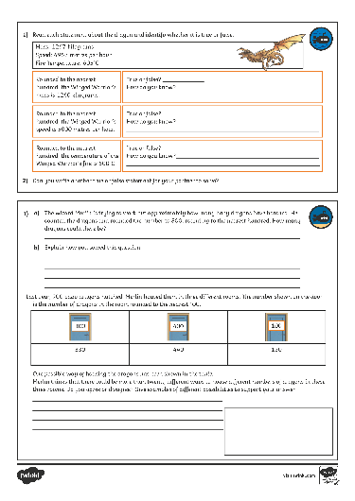
Rounding to the Nearest 100
Dive in by completing your own activity!

Slide 10
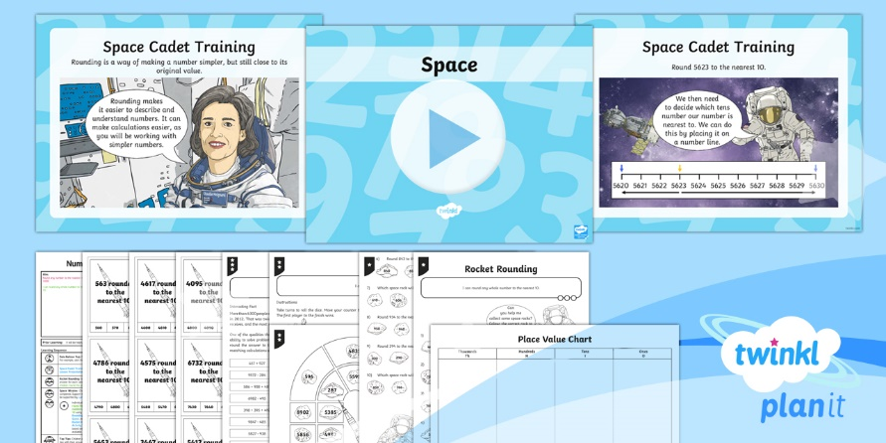
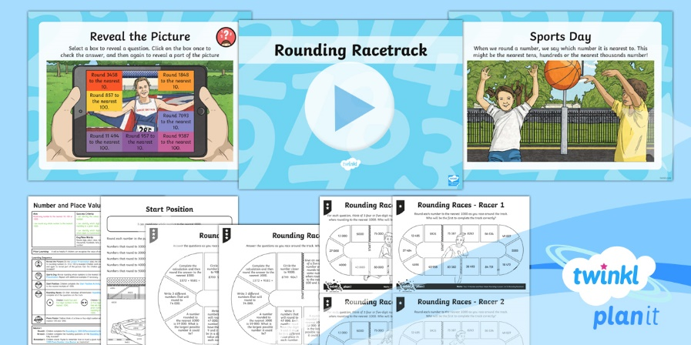
Need Planning to Complement this Resource?
National Curriculum Aim
Round any number to the nearest 10, 100 or 1000.
For more planning resources to support this aim, click here.
Twinkl PlanIt is our award-winning scheme of work with over 4000 resources.

