Slide 1
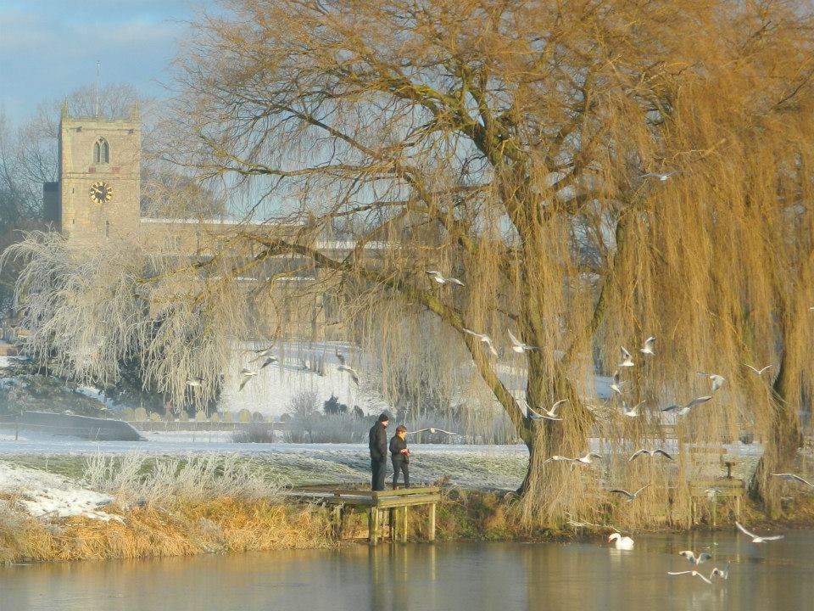
Warsop
By Demi, Rosie & Tarley
BY Demi Tarley Rosie

Slide 2
information
Warsop has a church, town hall and a park.
Warsop has four schools called Birklands, Hetts lane, Sherwood school and Meden.
Warsop has shops called Nisa, Co op, Fair price, Bakery shop, Dickensons, Subway and the Post Office.
At the church there is something called The Carrs, there is a park and there is a bmx track and its where you ride your bike.

